Slide 1
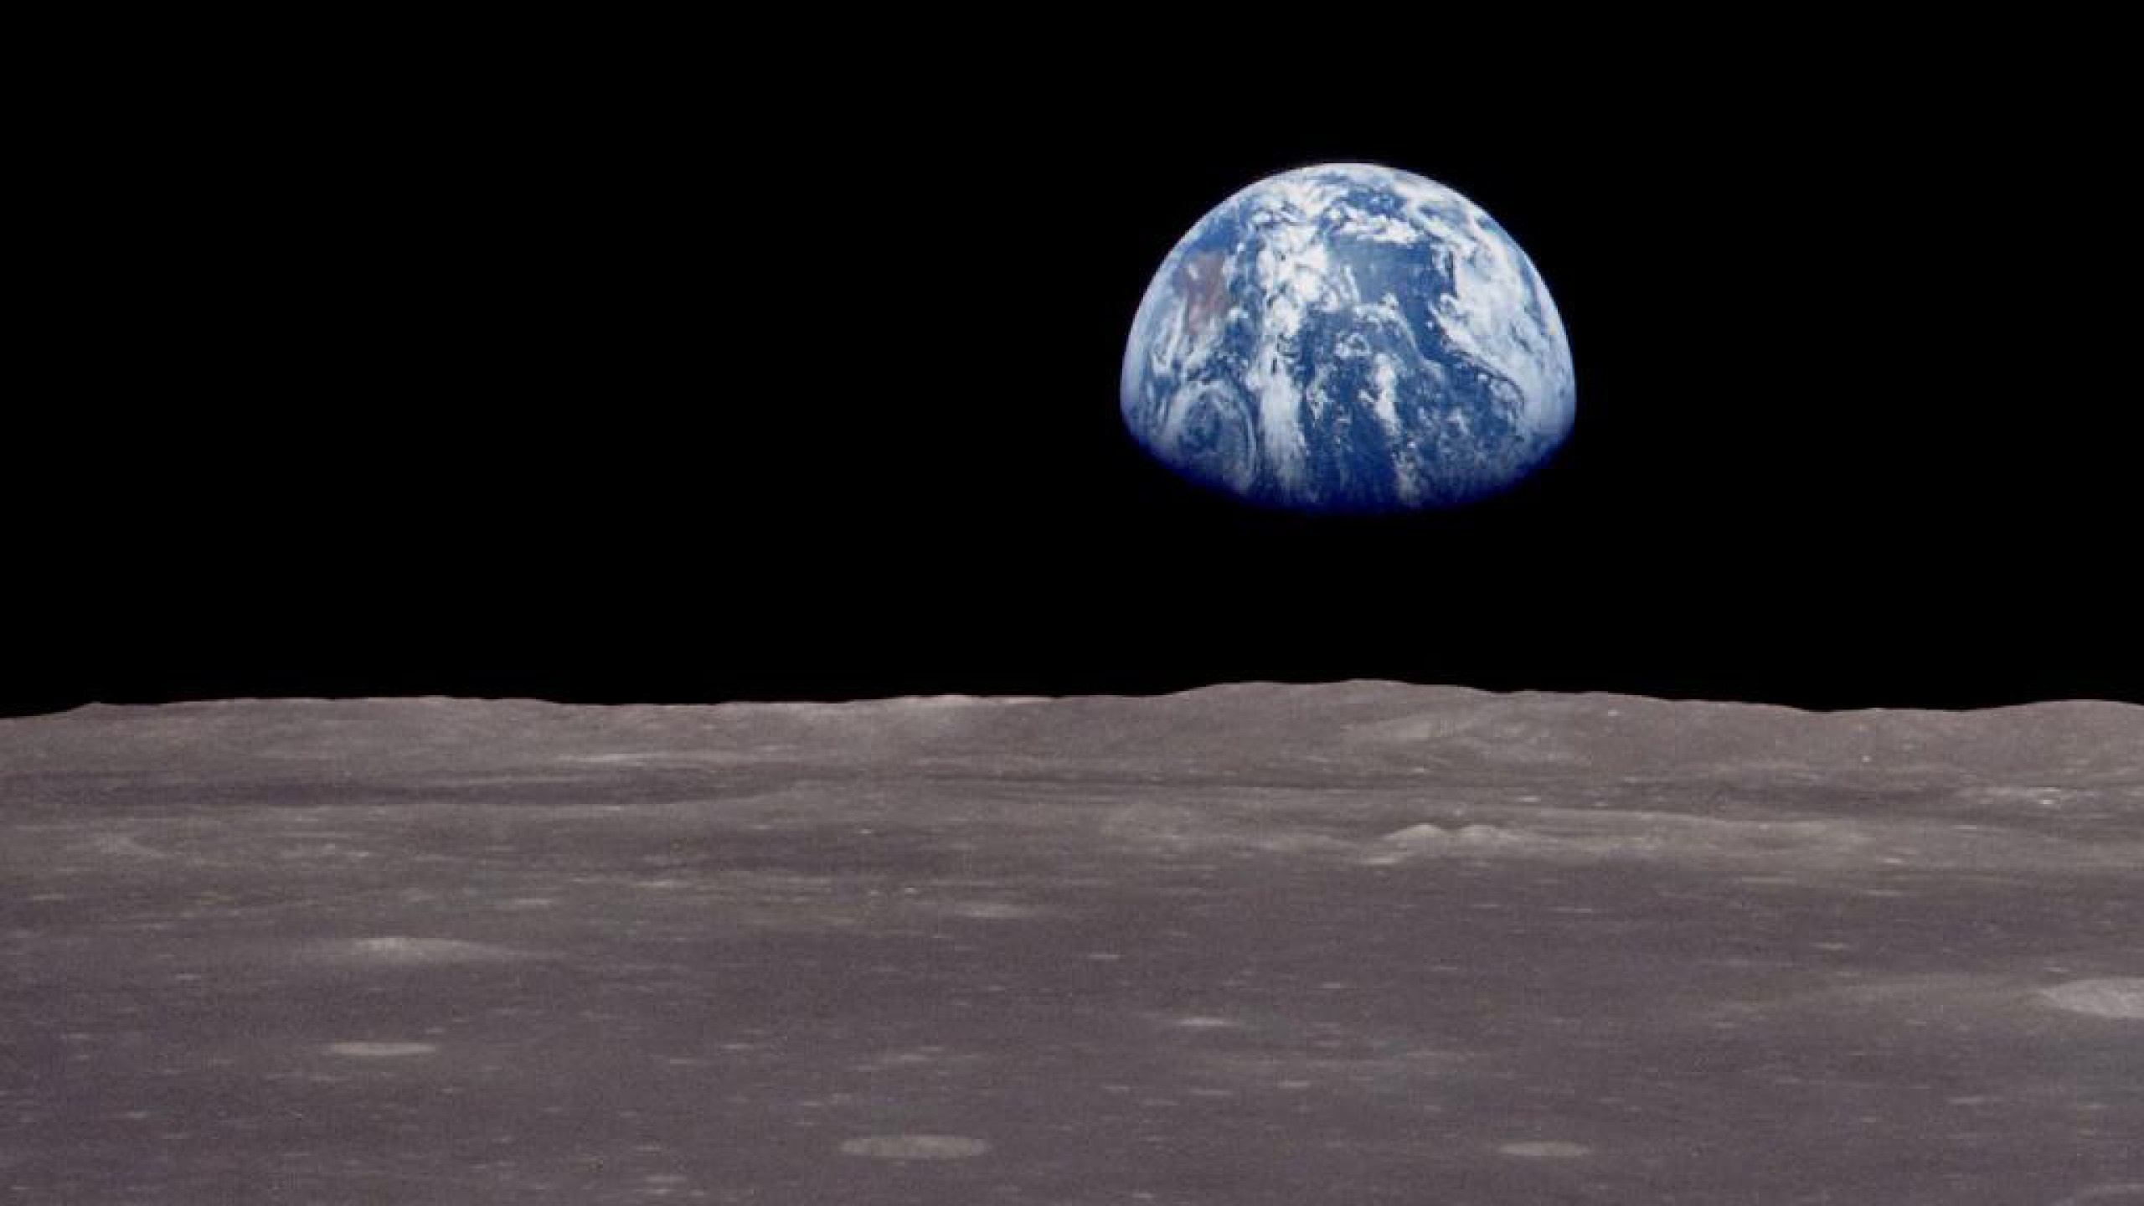
Climate Change Science, Mitigation, and Adaptation
Ted Weber
Dec. 16, 2021
https://www.tcweber.com/
Notes:
(This is the unabridged slide deck, considerably longer than the version I presented at WorldCon)
Thank you everyone for coming. I’m Ted Weber. I’m an author but also work as an ecologist and climate adaptation analyst. I have degrees in systems ecology and wetland ecology, am a certified forest ecologist, and have worked on wildlife, habitat, and climate-related projects for over 20 years for the State of Maryland, the Conservation Fund, and Defenders of Wildlife. First I’ll talk about the greenhouse effect and how it is increasing temperatures, melting glaciers, raising sea levels, and causing other negative effects. Then I’ll talk about ways people can reduce the amount of future warming and damage, and what can be done to adapt to the warming that’s already occurring. I’ll try to answer any questions at the end of the talk.

Slide 2
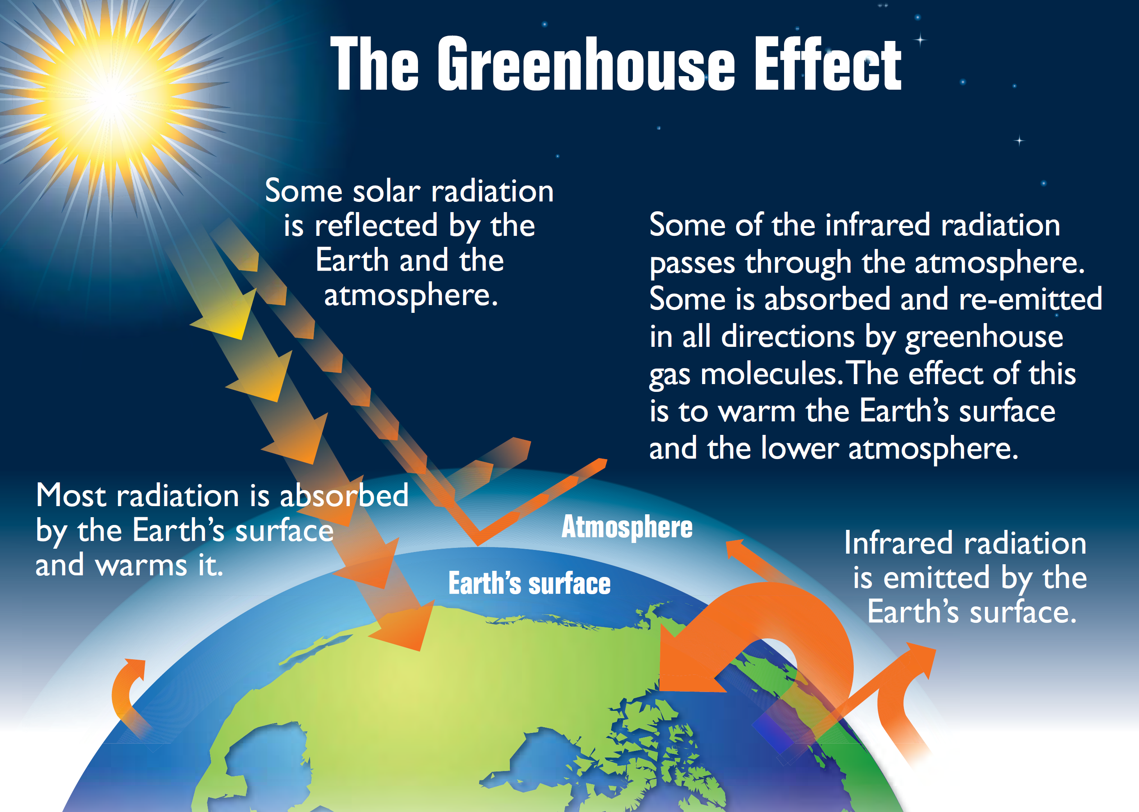
Source: EPA
Notes:
Let’s start with atmospheric physics. The energy from the sun comes into the Earth in the form of light radiation that cuts through the atmosphere and warms the planet. 29% of this energy is reflected back into space. Almost half is absorbed by the Earth’s surface. Some of this is radiated back to space as infrared radiation. Carbon dioxide, along with water vapor, methane, and a number of other molecules, is a greenhouse gas. It lets in the ultraviolet and light energy from the sun, but traps some of the longer-wavelength heat energy that radiates back from the surface of the Earth. Some trapping is good; it keeps the planet’s surface warm enough for life. But the problem is that we are increasing the concentration of greenhouse gases, which traps more of the outgoing infrared energy and is warming the planet beyond the levels at which ecosystems and human civilization are adapted.
The average solar radiation striking the top of the atmosphere is 340 watts per square meter.
29 percent is reflected back into space.
23 percent is absorbed by the atmosphere.
48 percent (almost half) is absorbed by the Earth’s surface.

Slide 3
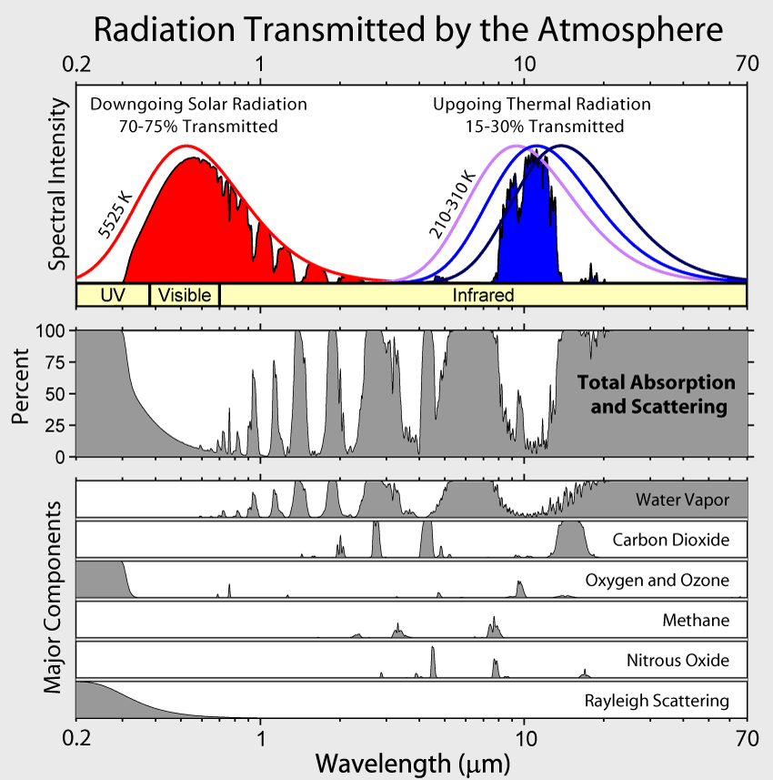
Notes:
These graphs show atmospheric absorption and scattering at different wavelengths. The largest absorption band of carbon dioxide is similar to the thermal emission wavelengths from the ground, and it also partly closes the window of transparency of water; hence its major effect.

Slide 4
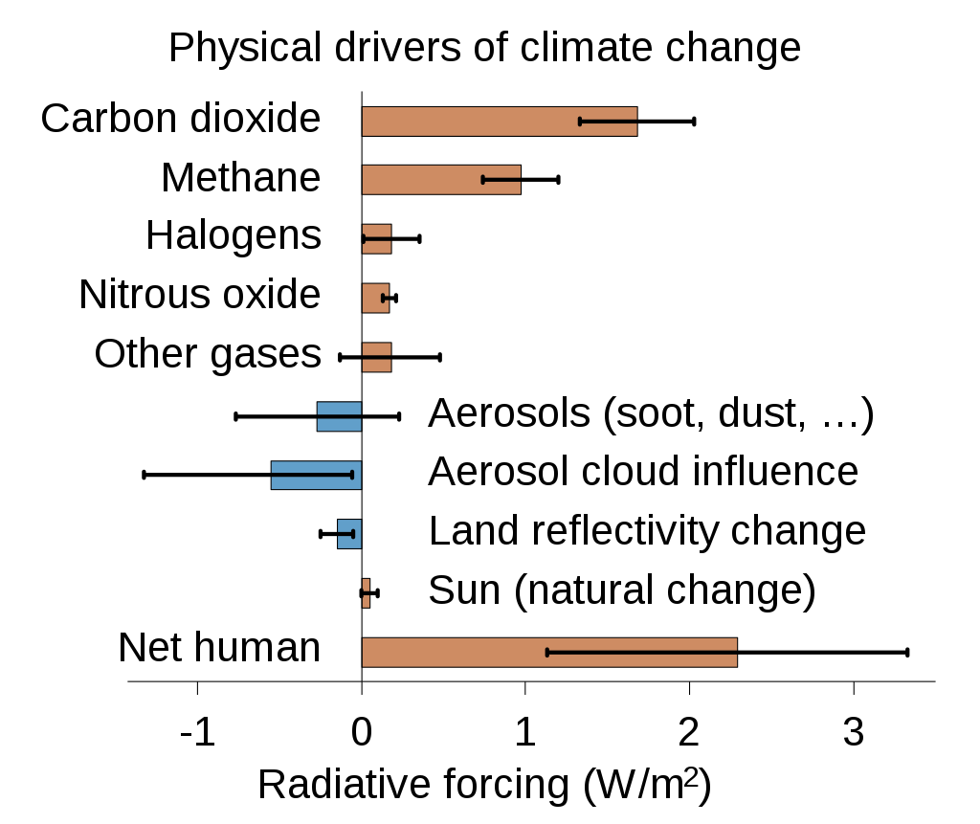
Notes:
This shows radiative forcing of different greenhouse gases.
Because it is the most abundant, CO₂ is the largest driver of climate change. And it remains in the atmosphere for thousands of years.
Methane only lasts about a decade in the atmosphere. But it absorbs much more energy than CO₂, and is the second most significant GHG.
Nitrous Oxide (N₂O) also absorbs more energy than CO₂. It remains in the atmosphere for more than 100 years, on average.
Chlorofluorocarbons (CFCs), hydrofluorocarbons (HFCs), hydrochlorofluorocarbons (HCFCs), perfluorocarbons (PFCs), and sulfur hexafluoride (SF₆) are sometimes called high-global warming potential gases because each molecule traps thousands of times more heat than a CO₂ molecule.

Slide 5
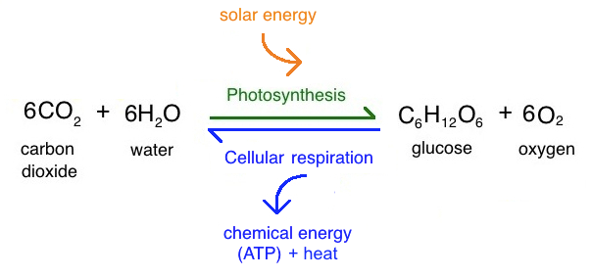
Photosynthesis and Respiration
Notes:
Where does CO2 come from? For the most part, from respiration and combustion. Photosynthesis is the process where plants and certain microbes use chlorophyll or other molecules to combine CO2 and water to produce glucose needed for maintenance and growth. Respiration is the opposite process, using oxygen to break down organic molecules into CO2 and water to produce energy. Burning oil, coal, or natural gas is like respiration, producing energy from long-buried organic molecules and releasing CO2 into the atmosphere.

Slide 6
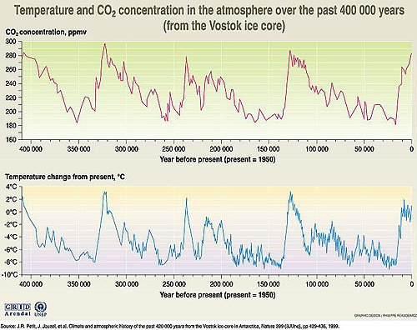
Notes:
Using ice cores, scientists have been able to track CO2 concentrations over the past 400,000 years. Temperatures follow CO2 concentrations almost exactly and caused changes big enough to start and end ice ages.

Slide 7
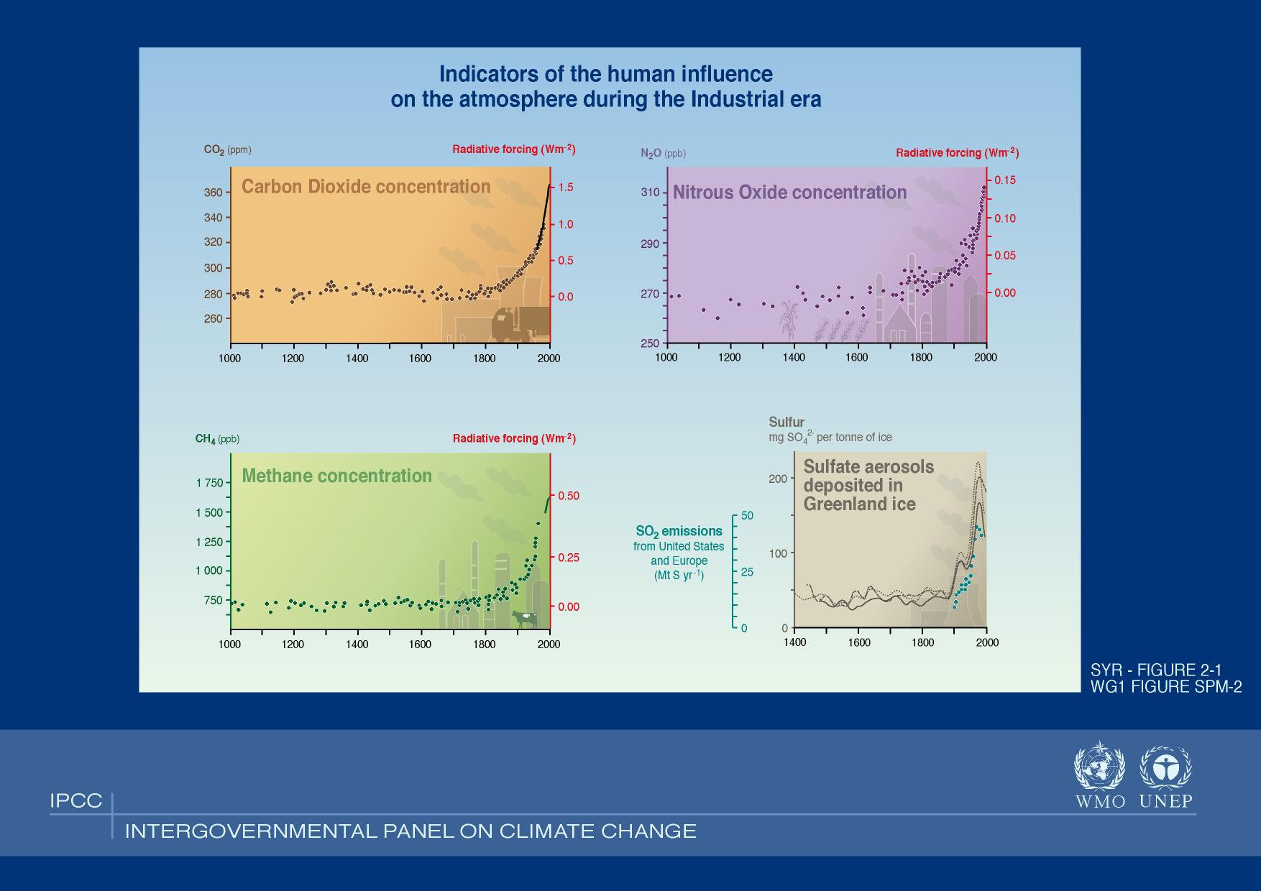
Notes:
As you can see here, CO2, Nitrous Oxide, Methane, and SO2 concentrations have all been increasing dramatically in the past 100 years.

Slide 8
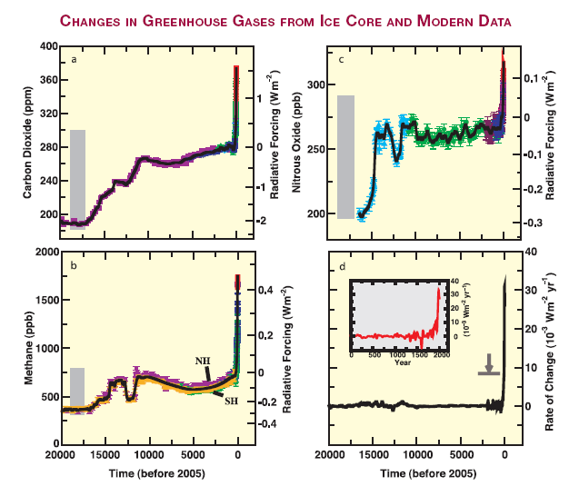
Grey bars:
natural variability
last 650,000 yrs
Rate of
change
of
combined
forcing
Source:
IPCC (2007)
Notes:
This shows the past 20,000 years. There is a massive uptick of greenhouse gases far above natural levels.

Slide 9
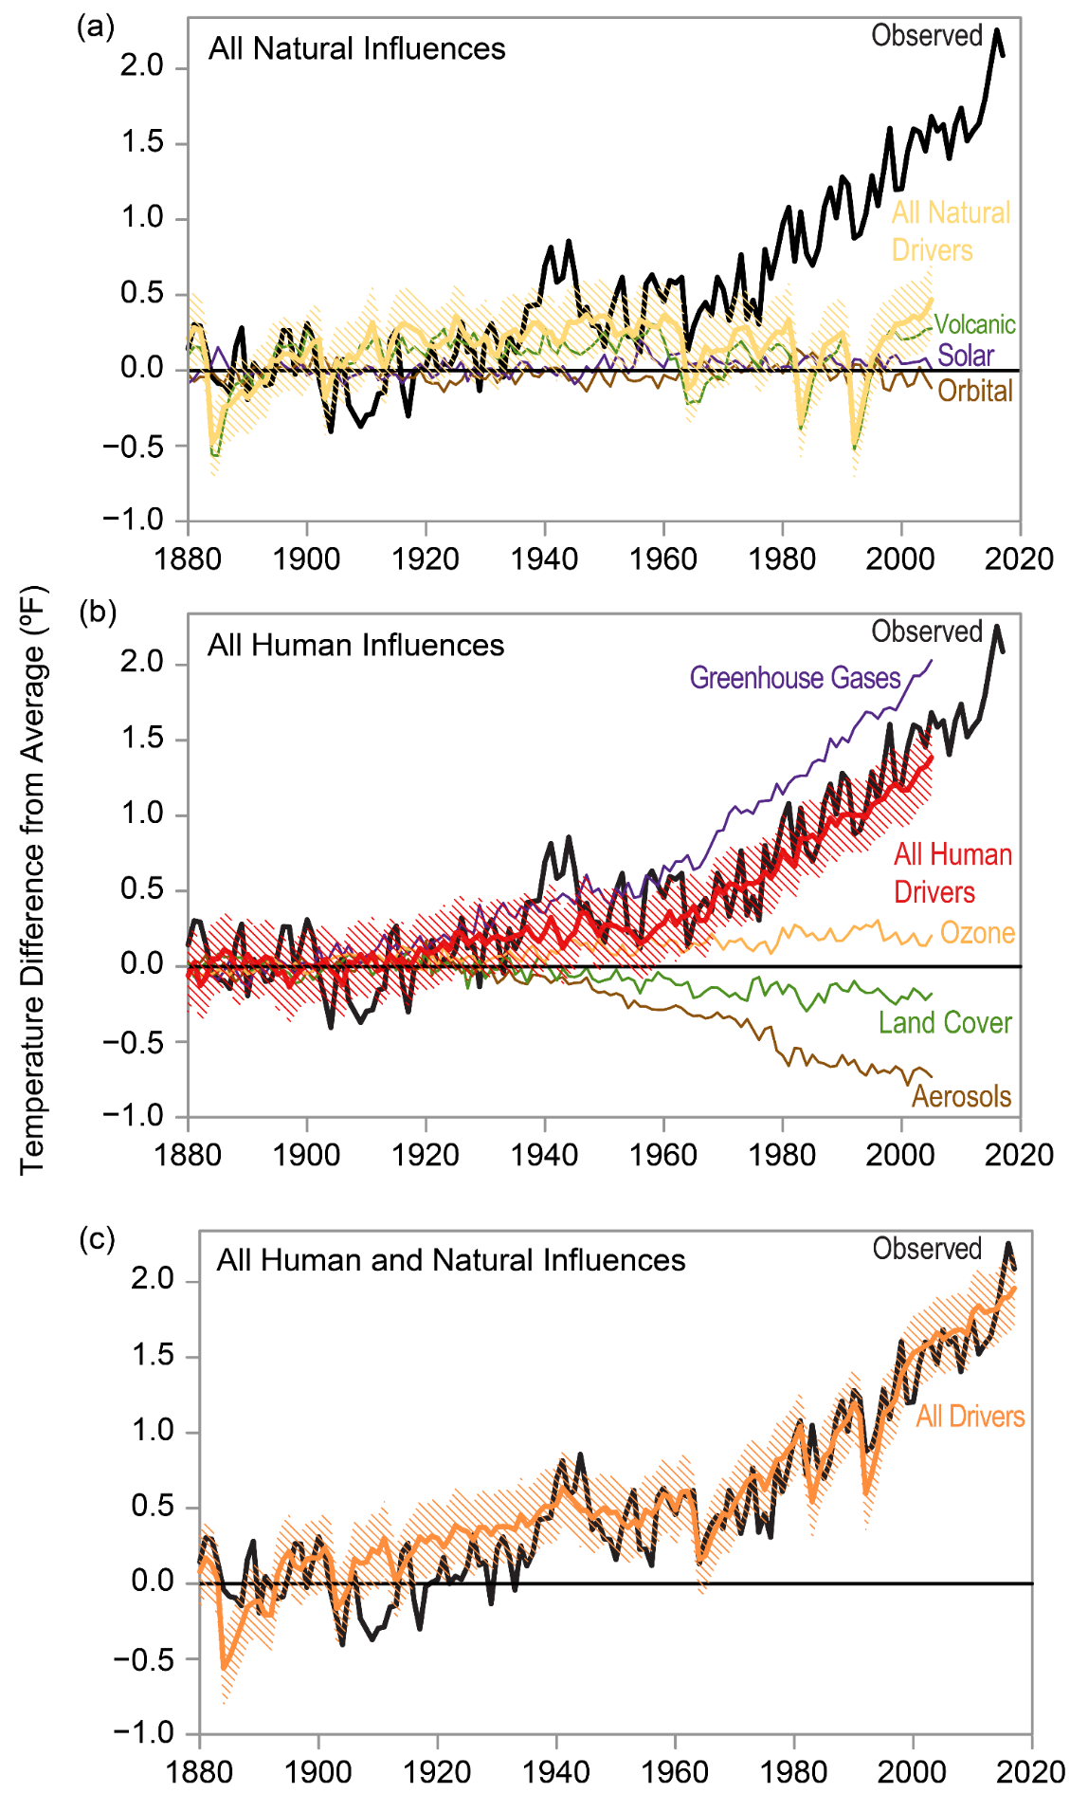
Source: Fourth National Climate Assessment (NCA), 2018
Notes:
The data show a very high correlation between surface temperatures and greenhouse gas concentrations. Next question, is this a natural process or is it human caused?
Graph (a) shows that natural temperature drivers like volcanic emissions, solar output, and orbital variances have remained flat over the past 140 years, whereas temperatures have increased sharply.
Looking at graph (b), human emissions of greenhouse gases, primarily fossil fuel combustion, moderated by the release of particulates like soot, match the observed temperature increases almost exactly.

Slide 10
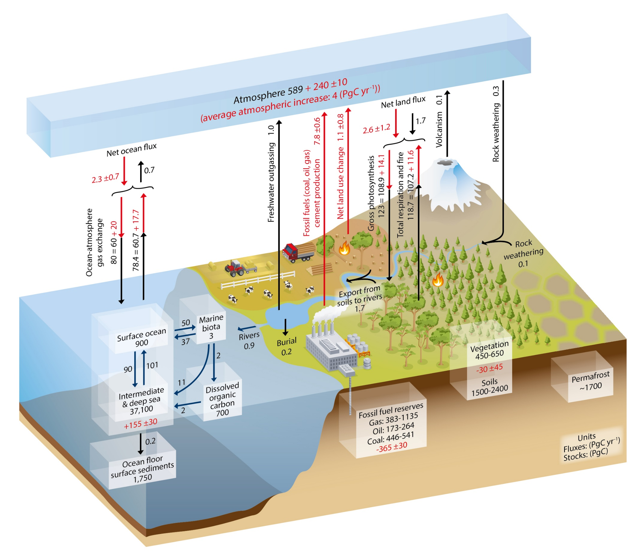
Source:
NOAA
Notes:
This diagram shows the stocks and fluxes of carbon in the land, ocean, underground, and the atmosphere. Numbers represent carbon stocks in petagrams of C (1 Pg = 1 billion metric tons) and annual fluxes (in PgC/yr). Black numbers and arrows indicate estimated mass and fluxes prior to the Industrial Era, about 1750. Red arrows and numbers indicate annual fluxes averaged over the 2000–2009 time period. First, you can see we’ve added around 240 PgC to the atmosphere, which continues to increase. This comes mostly from burning fossil fuels, but also from clearing forests and other natural land. A lot of carbon is stored in the oceans, soils, permafrost, and vegetation, as well as remaining fossil fuel reserves, quite a bit more than is currently in the atmosphere.
By convention, a positive cumulative change means that a reservoir has gained carbon since 1750. The cumulative change of anthropogenic carbon in the terrestrial reservoir is the sum of carbon cumulatively lost through land use change and carbon accumulated since 1750 in other ecosystems. Note that the mass balance of the two ocean carbon stocks. Surface ocean and Intermediate and deep ocean includes a yearly accumulation of anthropogenic carbon (not shown). Uncertainties are reported as 90% confidence intervals.

Slide 11
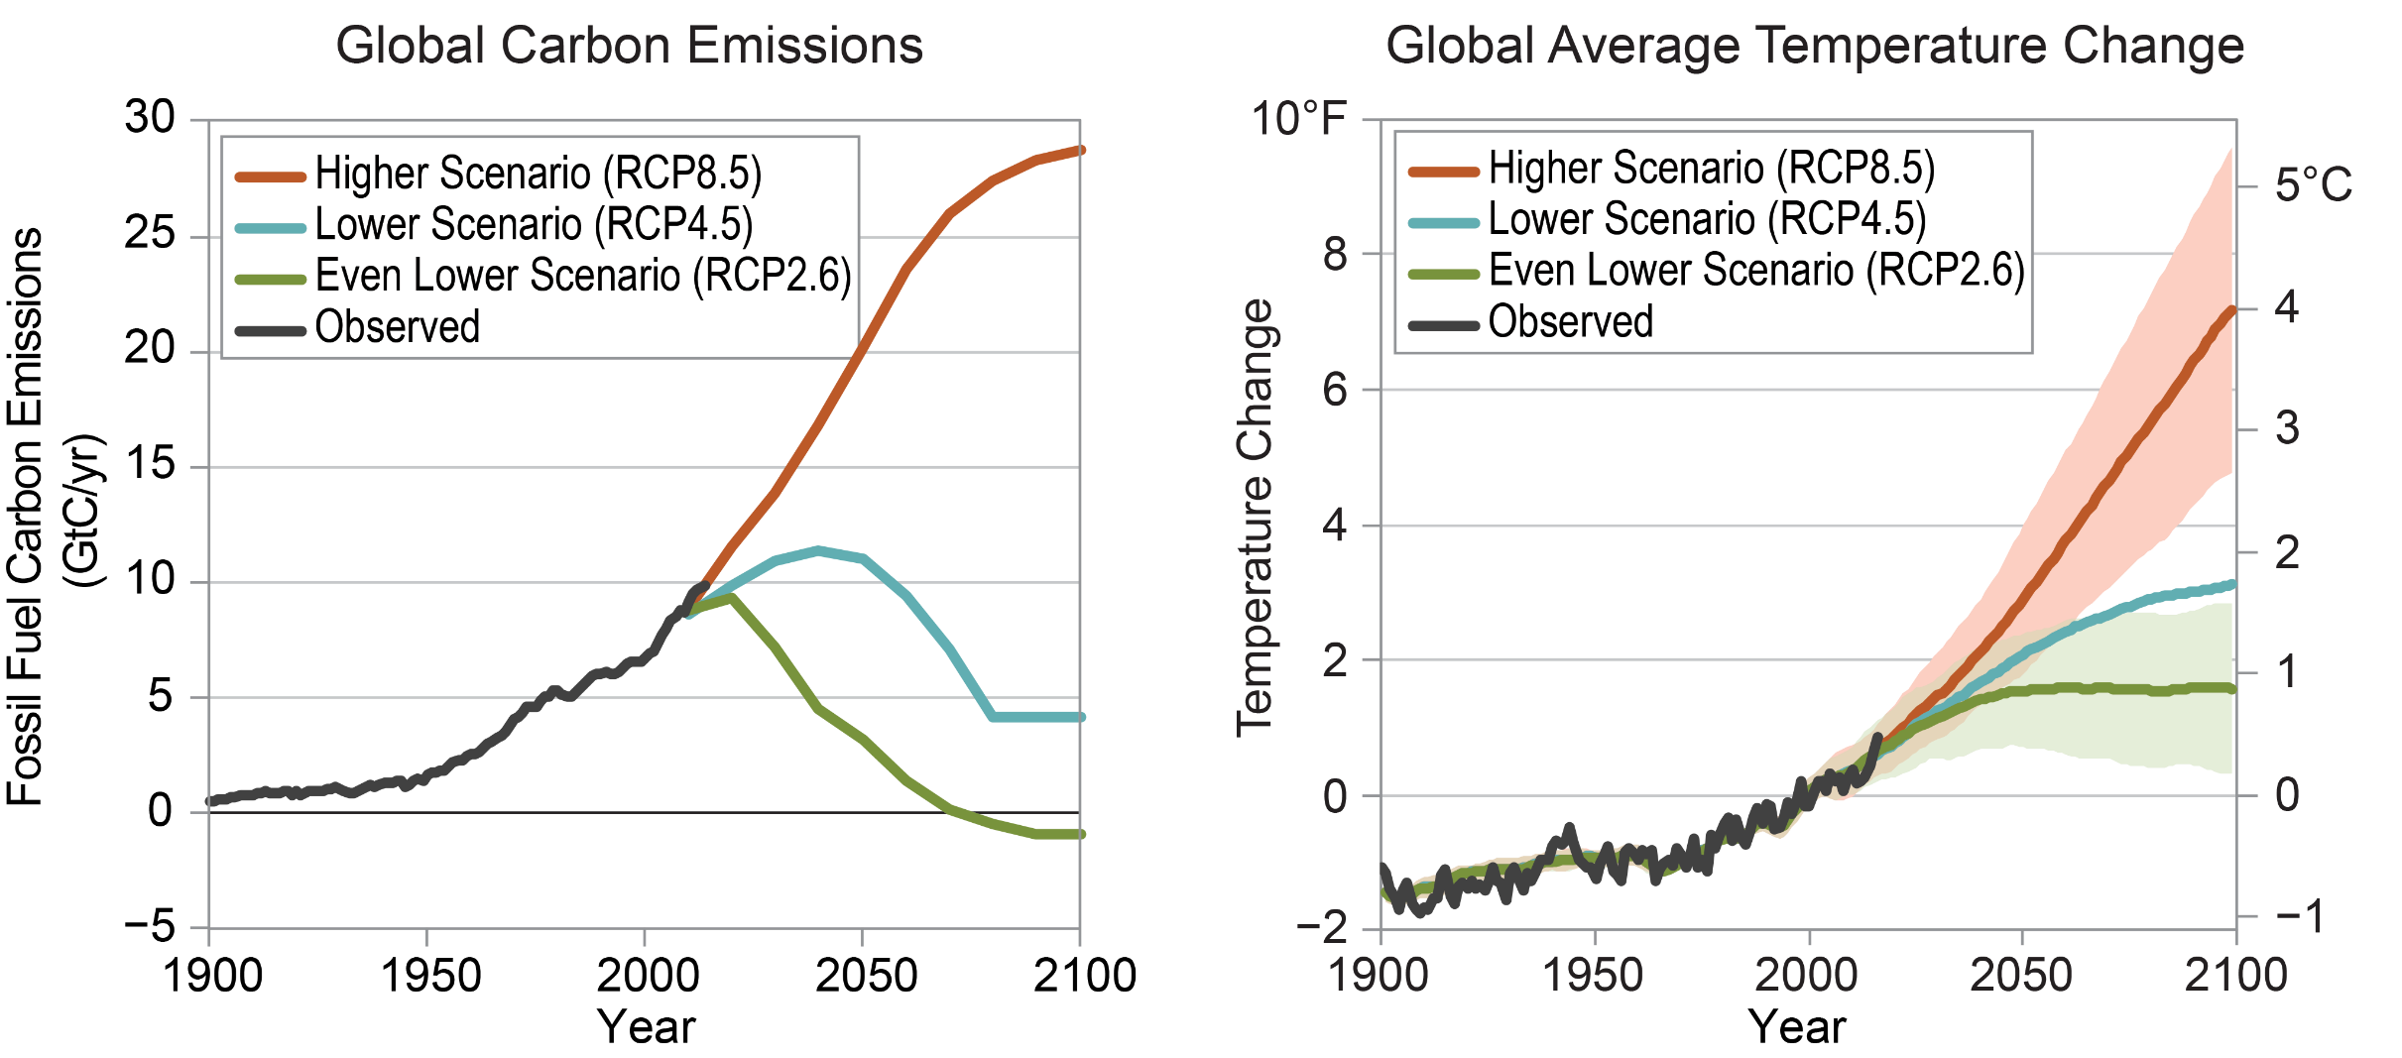
And the higher the greenhouse gas concentration goes . . .
Source: NCA 2018
. . . the higher the temperature will go.
Notes:
The more greenhouse gases in the atmosphere, the higher the temperatures. If we stop burning fossil fuels and destroying forests, we can limit the increase to 1-2 degrees Celsius. Otherwise, it could climb up to 4-5 degrees Celsius, which would have devastating consequences.

Slide 12
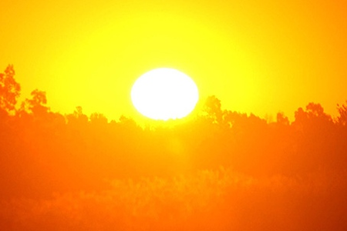
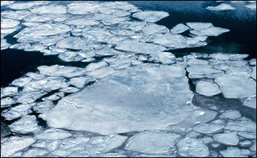
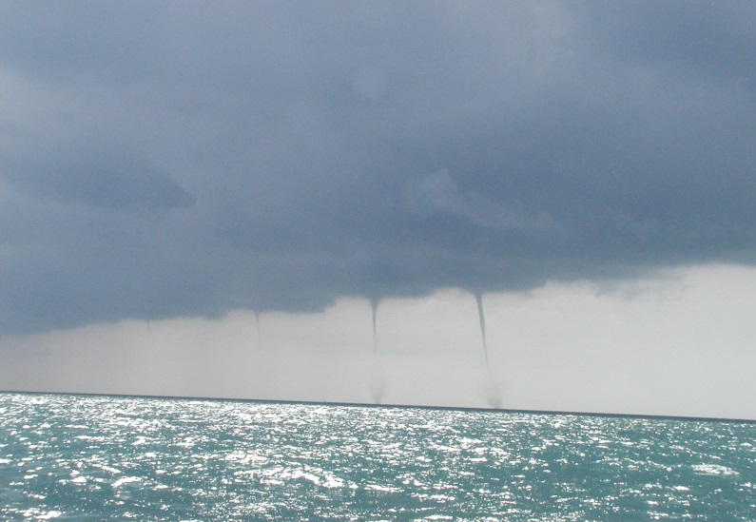
Where is that heat going?
What is it doing?
What are its impacts?
Images: NOAA
Notes:
Let’s talk about those consequences. Where is this extra heat going? What is it doing? What are its impacts? Some of the heat is going into the air, some is going into the oceans, some of it is melting ice, and some is evaporating water. These different pathways create different effects.

Slide 13
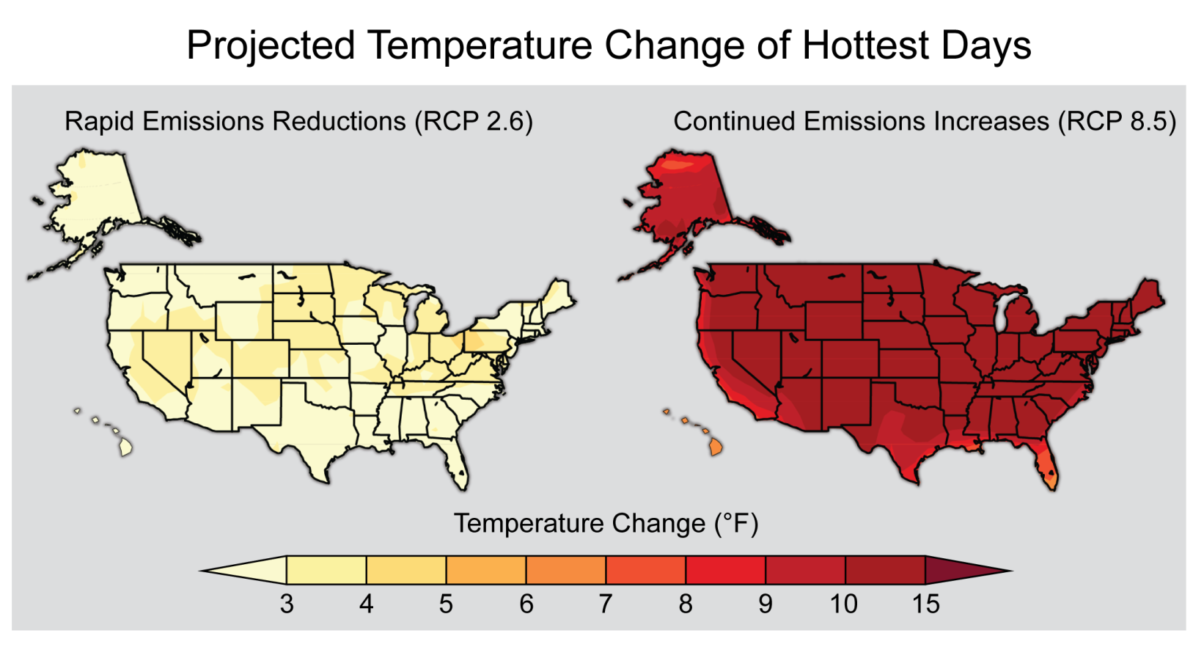
Higher Air Temperatures
NCA
Notes:
The most obvious effect is higher temperatures. This has adverse effects on ecosystems and people.

Slide 14
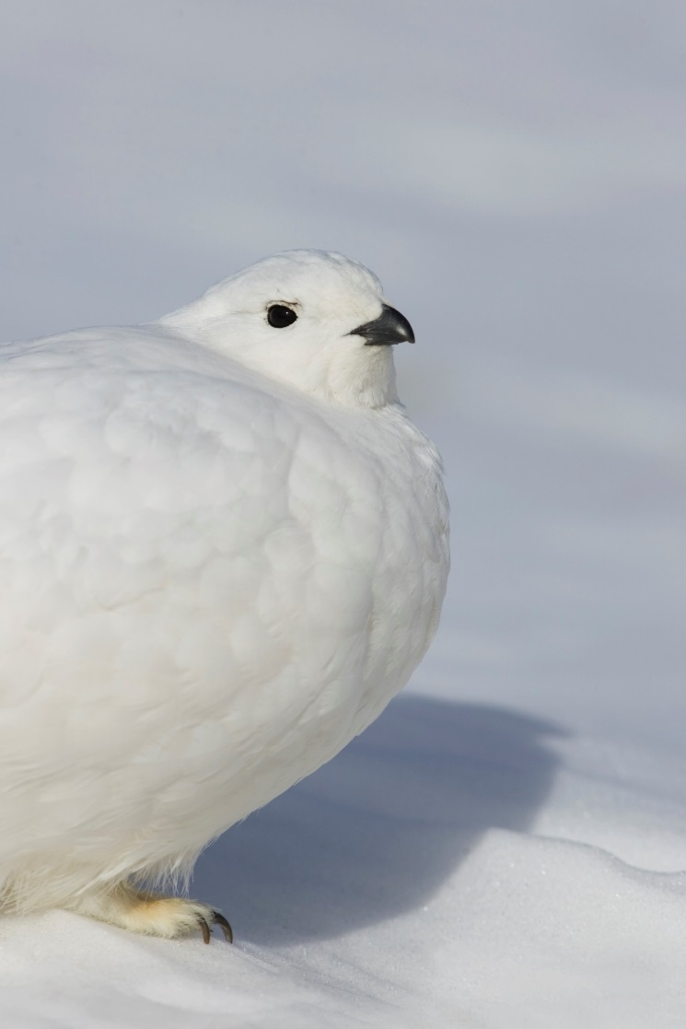
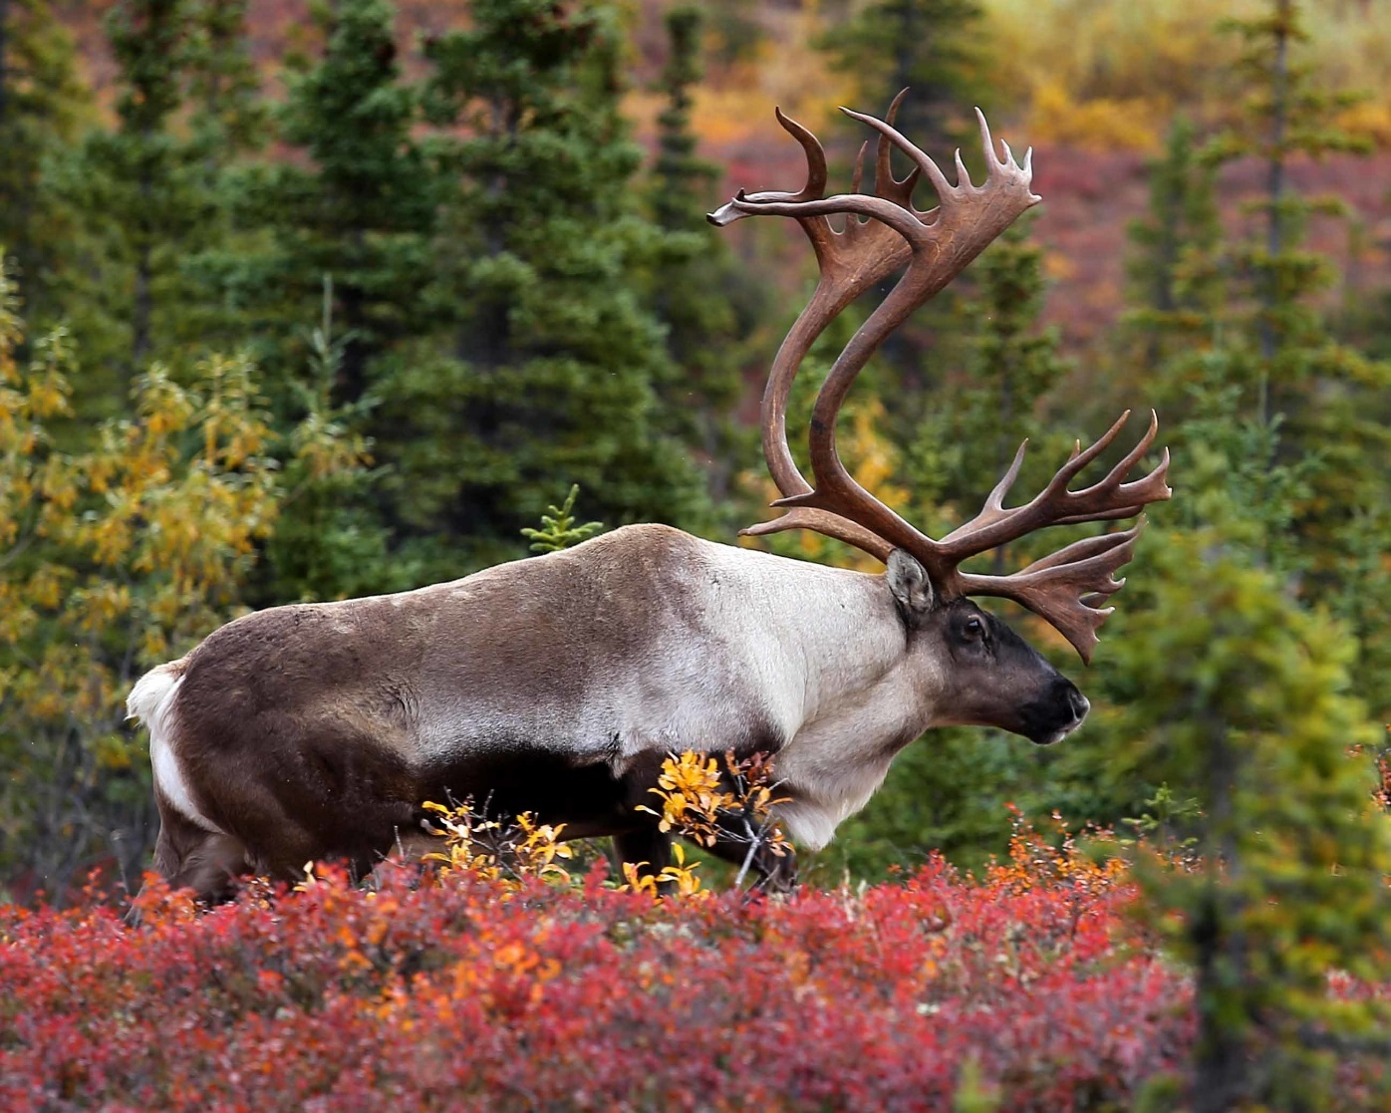
Some like it cold
Dan Walters
Laurence Laliberte
Notes:
Animals like moose, wolverines, Arctic foxes, and ptarmigans are adapted to cold weather and may not be able to survive in parts of their current ranges.

Slide 15
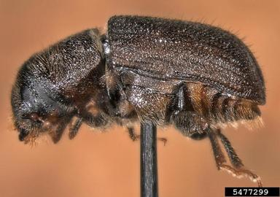
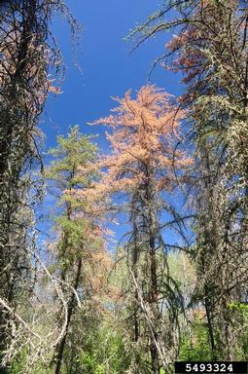
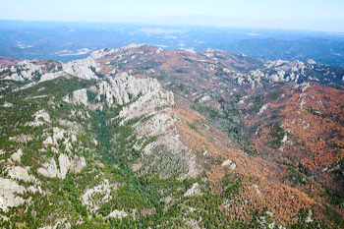
Some species* love warm winters!
*mostly pests, weeds, and diseases
Images: Javier Mercado, William Ciesla, Forest Service
Notes:
On the other hand, warm winters benefit pests, weeds, and diseases. Mountain pine beetles have killed almost 30 million acres of pine trees across the American west over the past decade. One of the reasons for the huge size of this outbreak is that the beetles are benefitting from longer growing seasons and less harsh winters.

Slide 16
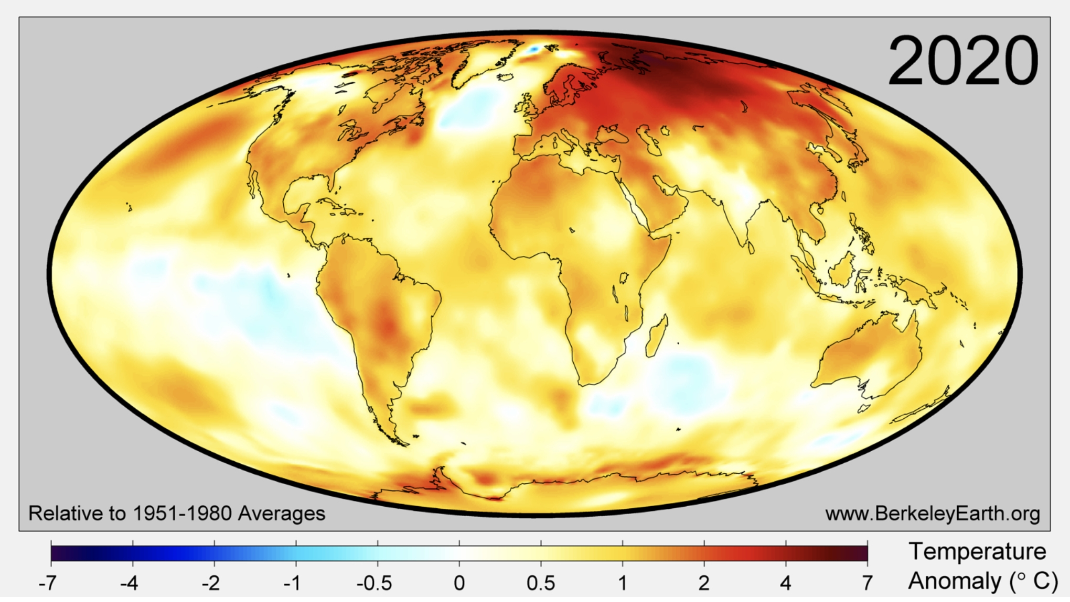
Notes:
The polar regions are warming fastest, especially Siberia and northern Alaska, which means trouble as the permafrost melts and releases methane. The southern Amazon is also warming rapidly, which is contributing to massive forest fires there. The Antarctic coast is also warming rapidly, which is causing its ice sheets to melt and slide into the ocean, raising sea levels.

Slide 17
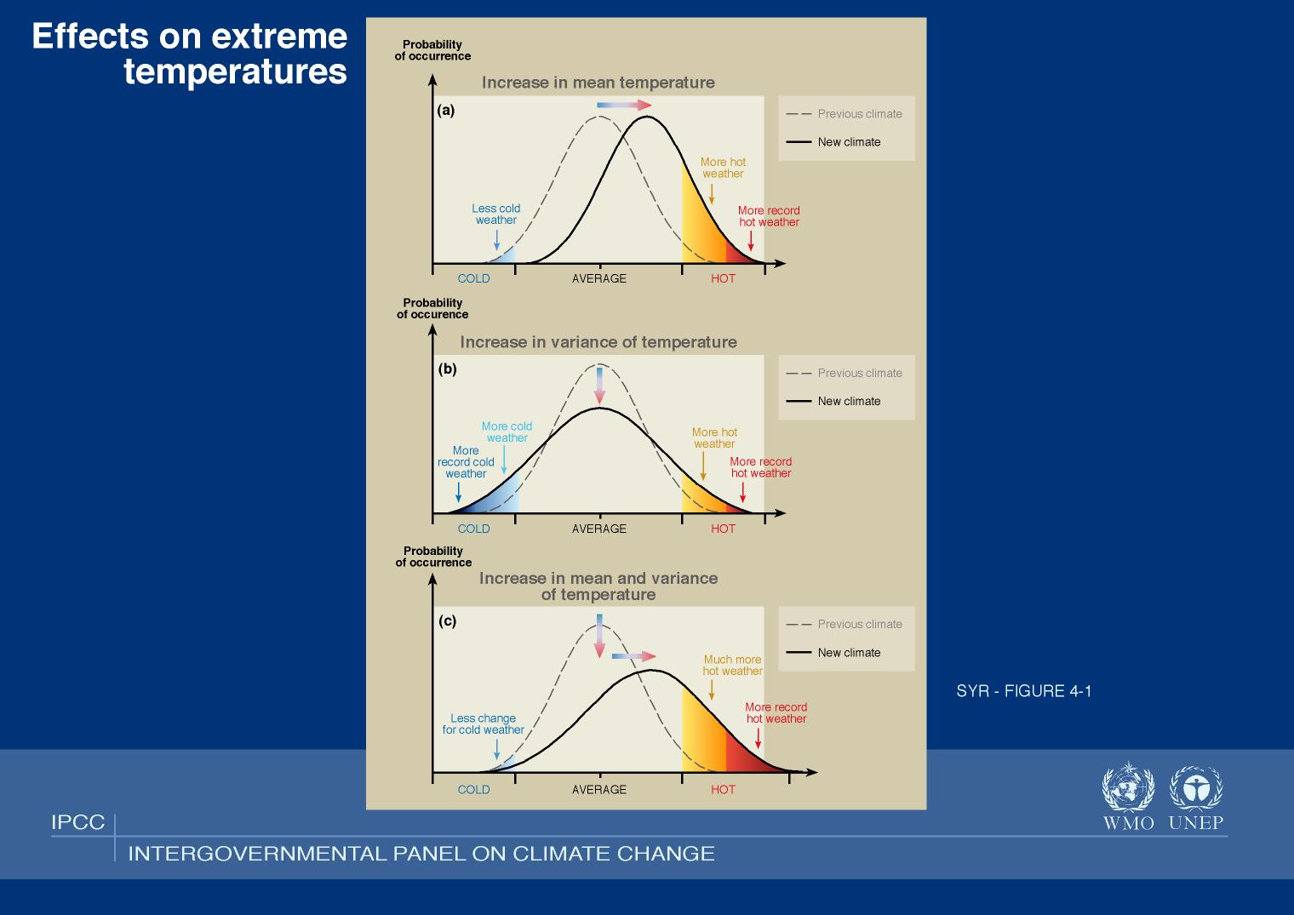
Notes:
Heat waves are becoming more frequent and more extreme.

Slide 18
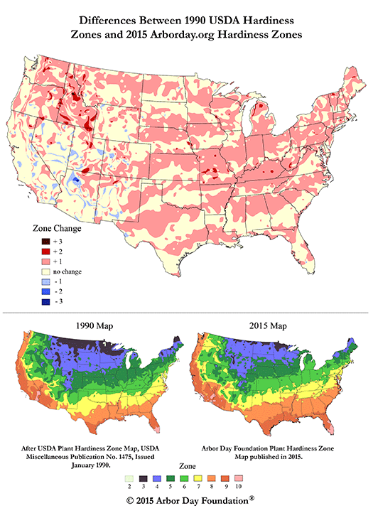
Winters are also warming
Notes:
Winters are also warming, which affects which plants and animals are best suited for a particular area.

Slide 19
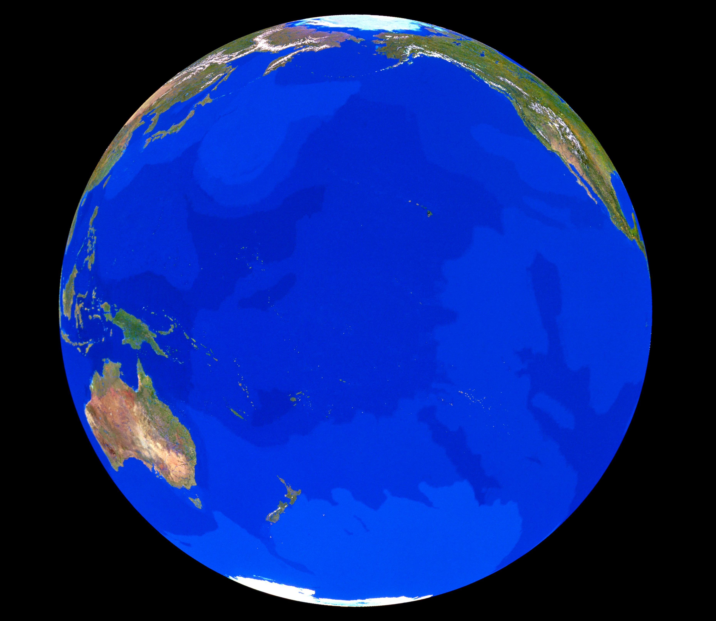
93% of the extra Heat
trapped by manmade
global warming pollution
goes into the
Ocean
© Tom Van Sant/Geosphere Project, Santa Monica/Science Photo Library
Notes:
93% of global warming heat goes into the ocean.

Slide 20
Ocean Temperatures Set a New Record in 2019
2020 is likely to set a new record again.
Change in Heat Content (Upper 2,000 m)
Relative to 1981-2010 Avg. (ZJ)
Data: Cheng, L. J., and J. Zhu, 2018: “2017 was the warmest year on record for the global ocean,” Advances in Atmospheric Sciences, 34(3)
Notes:
And so like land temperatures, ocean temperatures are rising.
2020 is likely to be the hottest year ever measured in the oceans. Along the Northeast Continental Shelf, ocean temperatures rose three times faster than the global average. This regional warming is accelerating dramatically, with temperatures now rising 0.25°F (0.14°C) per year (between 2007 and 2016 (NCA4)). Sea surface temperatures are projected to increase an additional 2.3°F-4.9°F (1.3-2.7°C) by 2100, depending on the emissions scenario (NCA4).

Slide 21
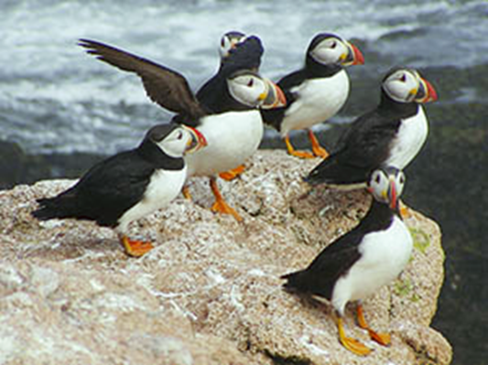
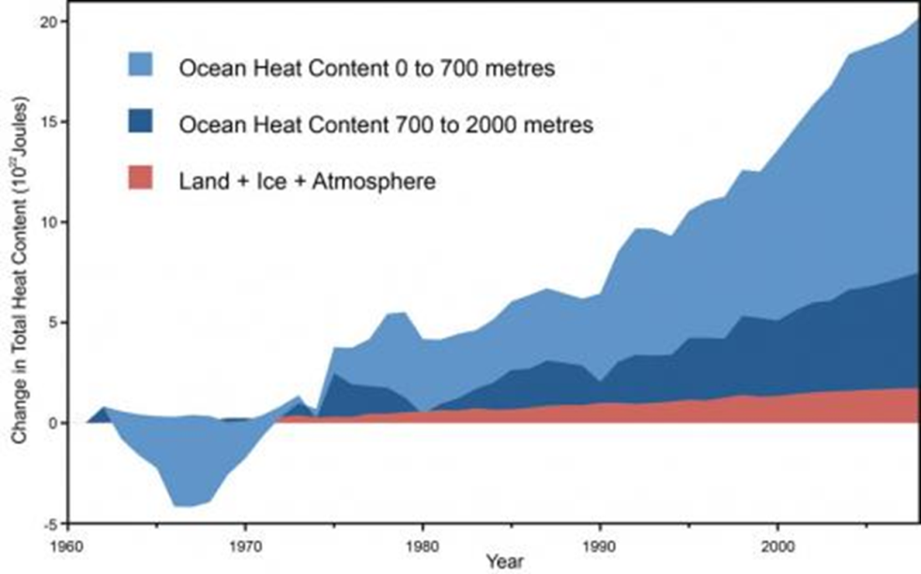
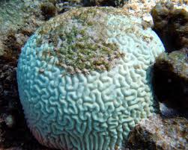
Warming Oceans
FWS
NOAA
Notes:
NOAA’s Northeast Fisheries Science Center has documented northward or deeper water shifts in nearly three-quarters of species that it has investigated, including important species like lobsters, mackerel, cod, flounder, haddock, and shad.
Rising sea temperatures are leading to changes in fish populations off the coast of Maine, where many puffin parents raise their young. Only 31% of puffin chicks are now surviving, compared to 77% before.
Algal blooms are exacerbated by warmer oceans and large precipitation events, and are harmful to seabirds, turtles, dolphins, whales, manatees, fish.
Of special concern, warmer waters cause coral bleaching:
Coral reefs are some of the most biodiverse habitats on the planet, home to nearly one-quarter of all ocean species.
Prolonged high water temperatures (among other factors) can cause coral polyps to expel their symbiotic algae partners that help them produce food.
The result is coral bleaching, which can kill the coral and puts the health of the whole reef system at risk.
The world’s largest reef, the Great Barrier Reef off the Australian coast, frequently suffers from catastrophic bleaching events in response to regular heat stress.
In 2016, an estimated 30% of the Great Barrier Reef’s corals died.

Slide 22
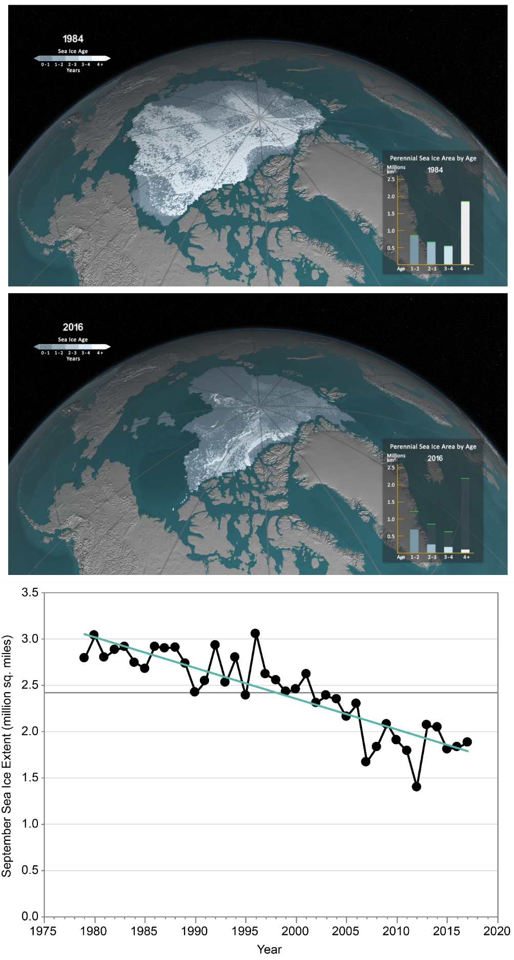

Melting Sea Ice
NCA, 2018
Notes:
Arctic sea ice has decreased, on average, between 3.5% and 4.1% per decade since the early 1980s. In September, when ice coverage reaches its annual minimum, the extent has decreased 10.7-15.9% per decade. Arctic sea ice loss is expected to continue, very likely resulting in nearly ice-free late summers by the 2040s.

Slide 23
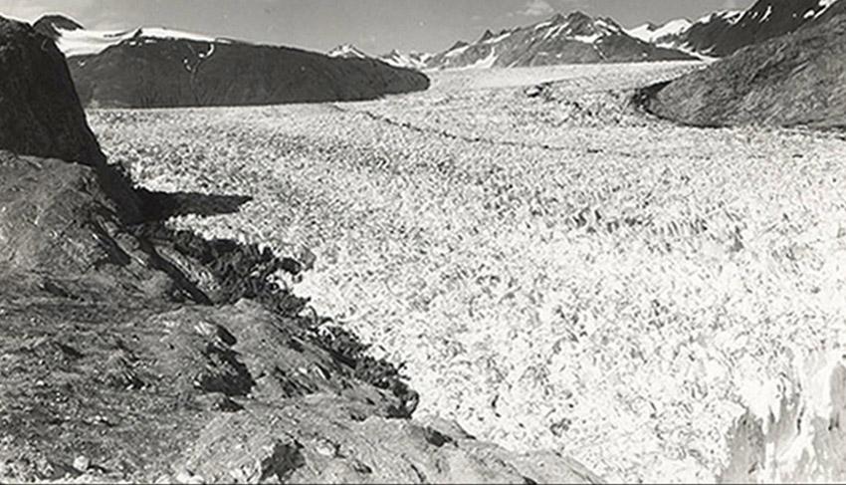
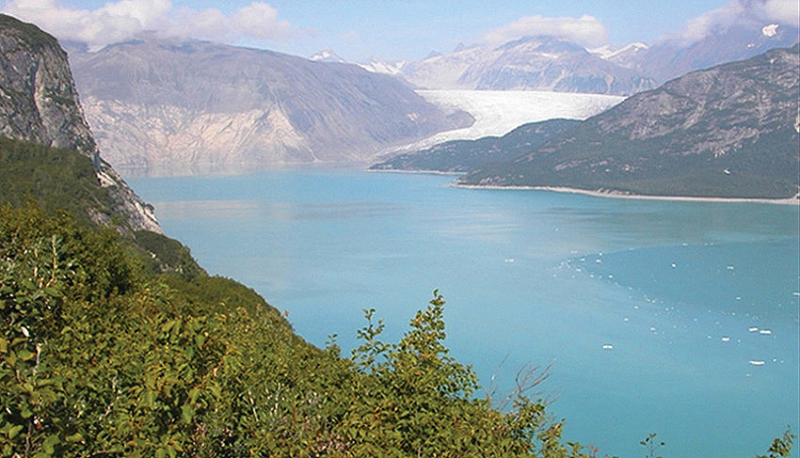
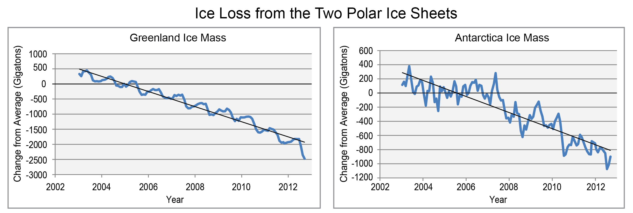
Land-based ice is also melting
Images: National Climate Assessment
Notes:
Glaciers and ice sheets are also melting rapidly.

Slide 24
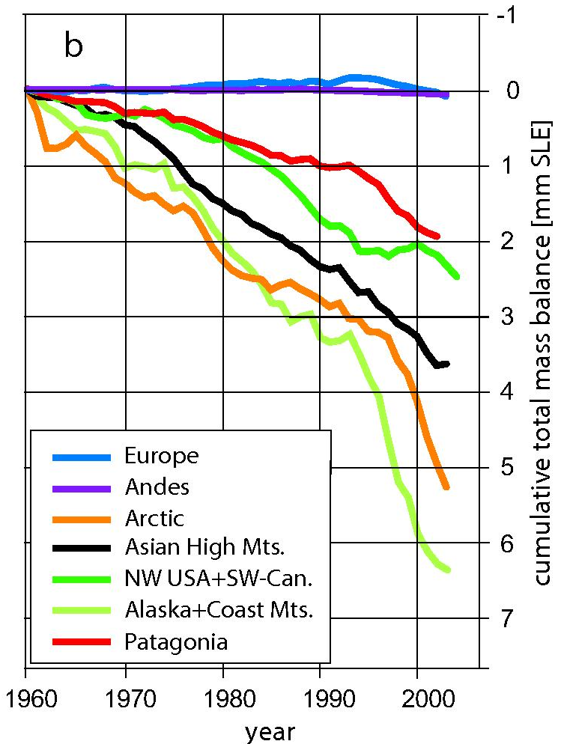
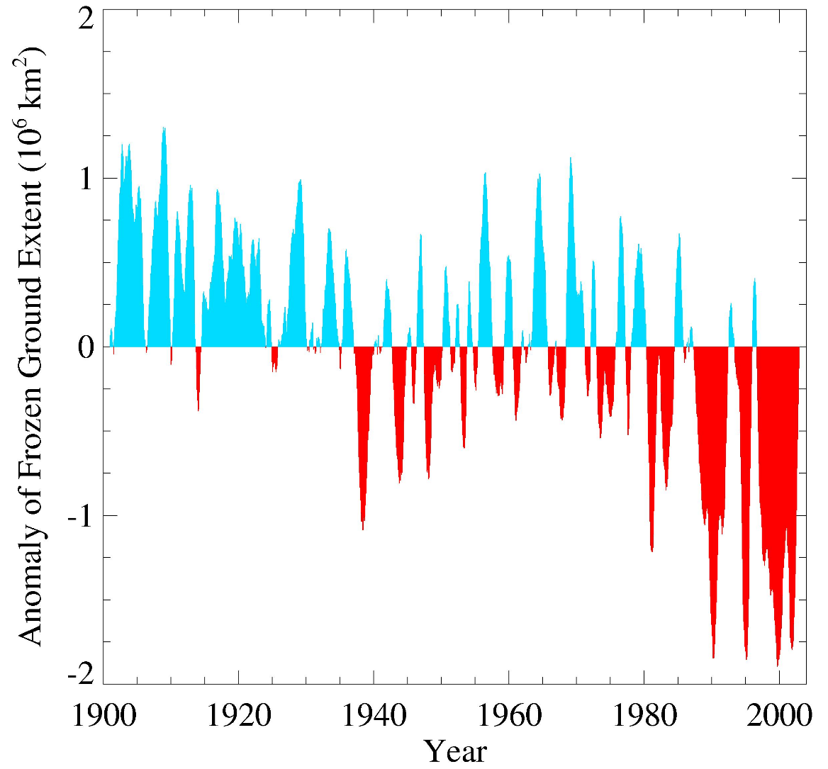
Glaciers and frozen ground are receding
Area of seasonally frozen ground
in NH has decreased
by 7% from 1901 to 2002
Increased glacier retreat since the early 1990s
Notes:
This shows how ice melting is accelerating. Seasonally frozen ground is also decreasing. Spring snow cover extent, maximum snow depth, snow water equivalent in the western United States, and extreme snowfall years in the southern and western United States have all declined, while extreme snowfall years in parts of the northern United States have increased. Large snowpack declines are projected for the western United States, meaning less water will be available for river flow, irrigation, and drinking water.

Slide 25
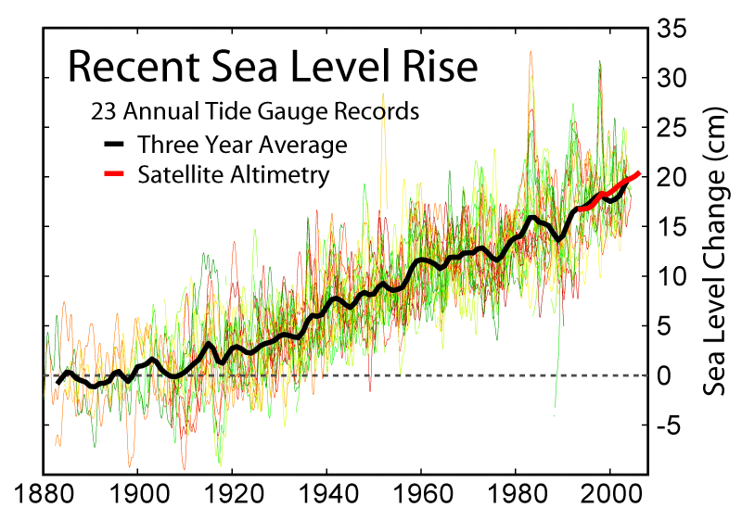
Notes:
Melting land ice and thermal water expansion are raising ocean levels. They have already risen an average of 20 cm since 1900.

Slide 26
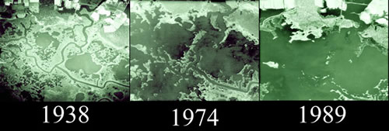
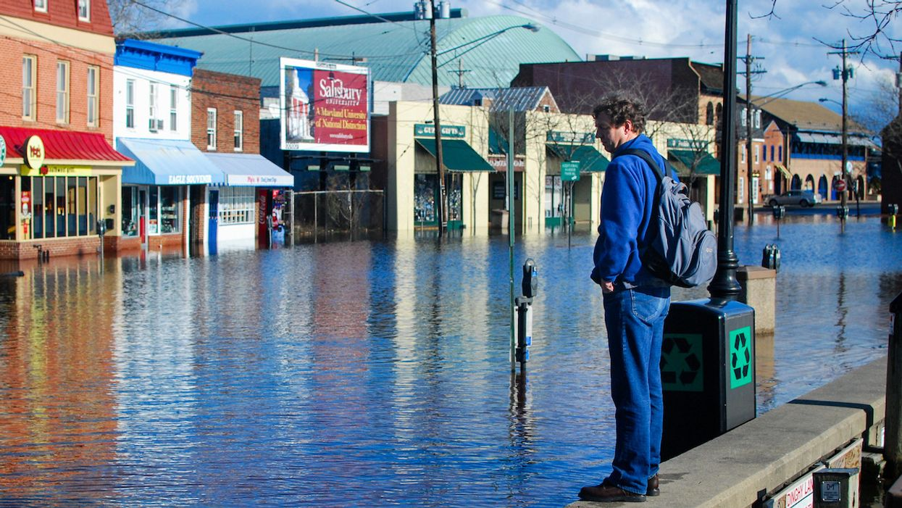
Blackwater Refuge, Maryland
(image: USFWS)
Annapolis, Maryland
(photo: Chesapeake Bay Program)
Notes:
Sea level rise has dramatic effects in flat areas, and it is accelerating. More than 5,000 acres of wetlands have been lost in Blackwater National Wildlife Refuge since the late 1930s. Annapolis, MD, where I live, is flooded by normal high tides now. Annapolis experienced 63 high-tide floods in 2017, compared with about four in the early 1960s.

Slide 27
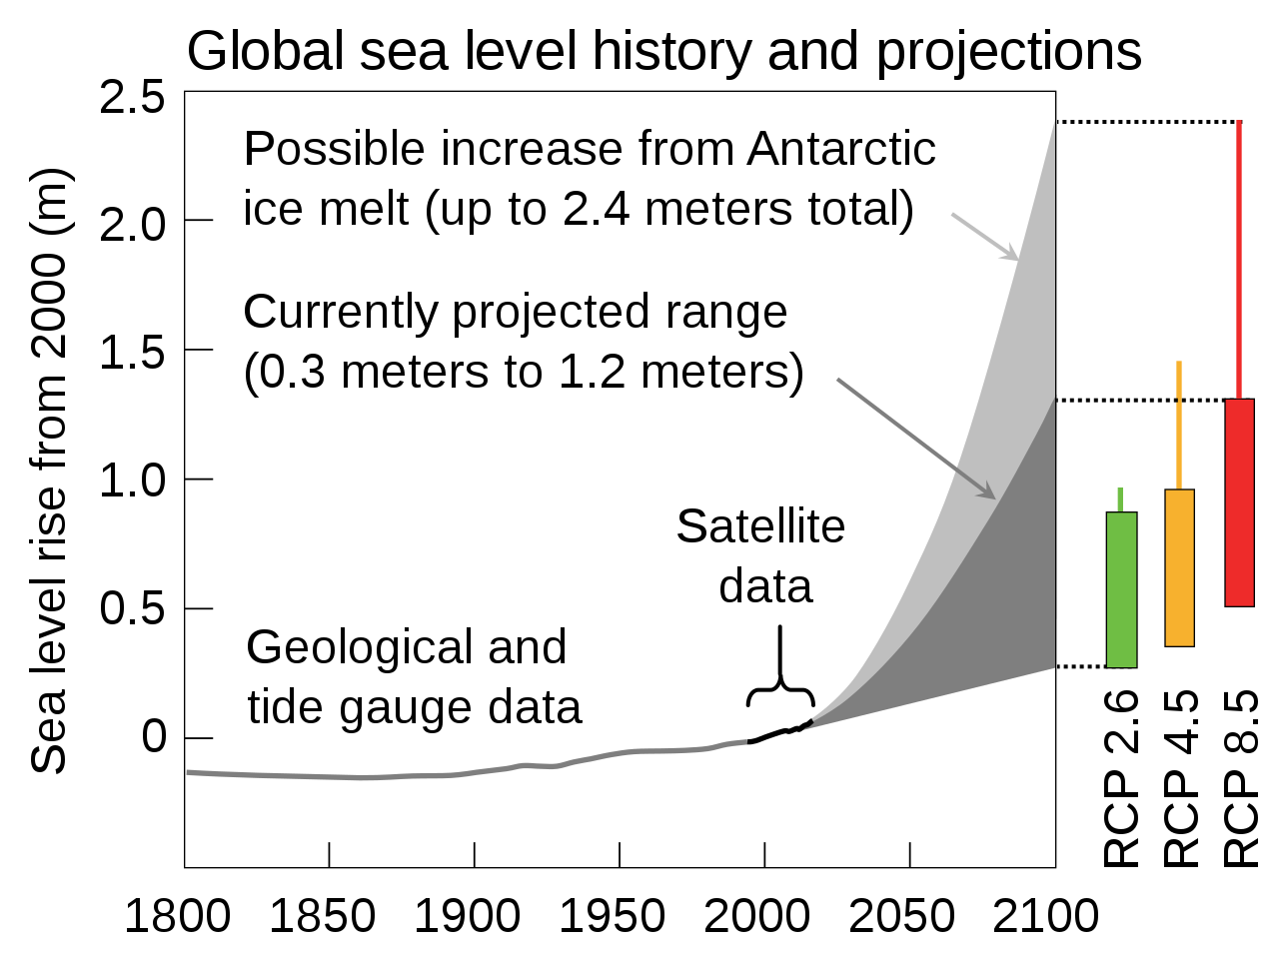
Source: NCA
Notes:
Sea level is projected to increase up to 2.4 meters by 2100, or 8 feet. We are seeing dramatic tipping points in Greenland and Antarctica with major ice sheets collapsing into the sea.
RCP 2.6 is the scenario where emissions peak before 2020—which they haven’t--RCP 4.5 the one where they peak around 2040, and RCP 8.5 the one where they keep increasing as usual.

Slide 28
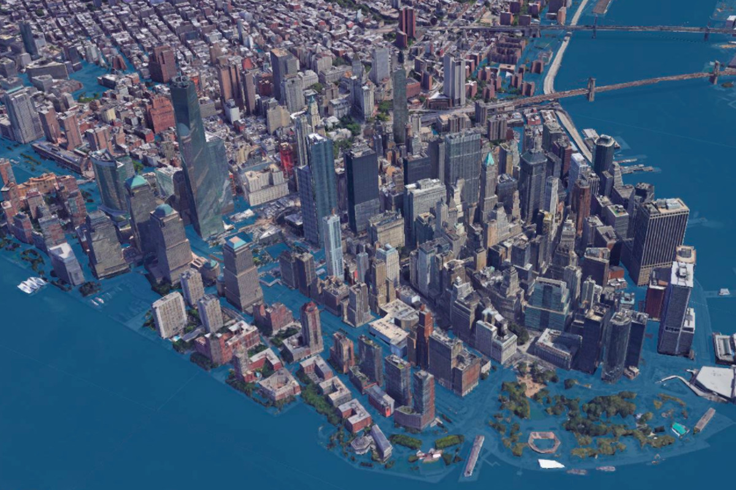
New York City with 2.5 m (8 ft) of sea level rise
(source: Climate Central)
Notes:
Here’s what NYC would look like with 2.5 meters of sea level rise.

Slide 29
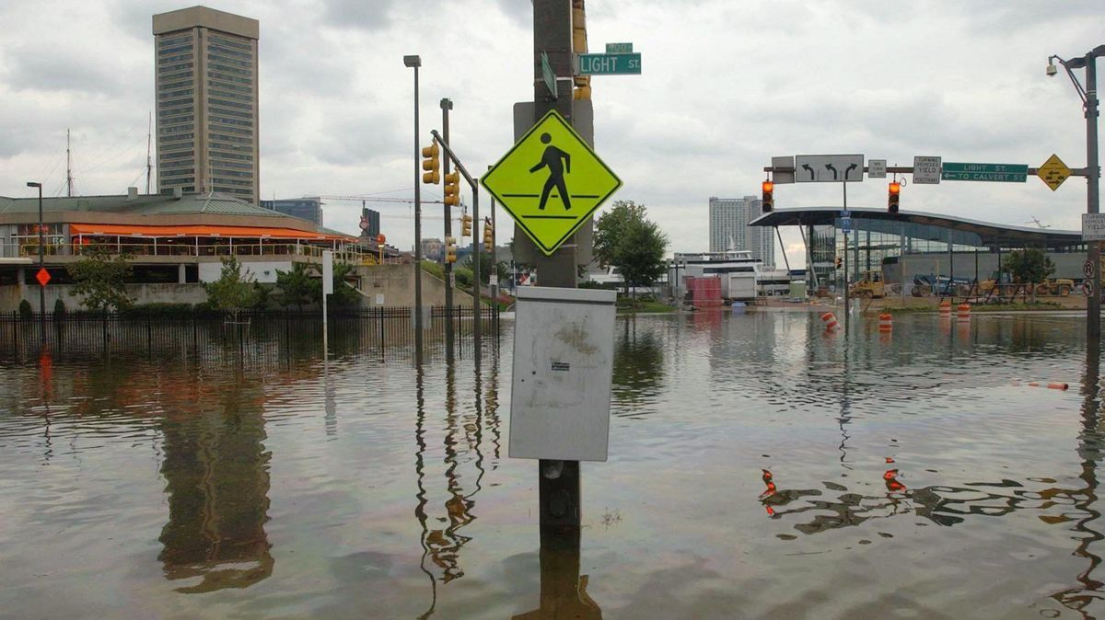
Photo: Baltimore Sun
Notes:
And here’s what Baltimore could look like.

Slide 30
Warmer water temperatures
(more evaporation)
+
Warmer air temperatures
(more evaporation/ evapotranspiration, increased water-holding capacity)
=
Bigger storms
Worse droughts
Notes:
Warmer temperatures cause more evaporation and increased vapor concentrations in the air, which leads to bigger storms and worse droughts.

Slide 31
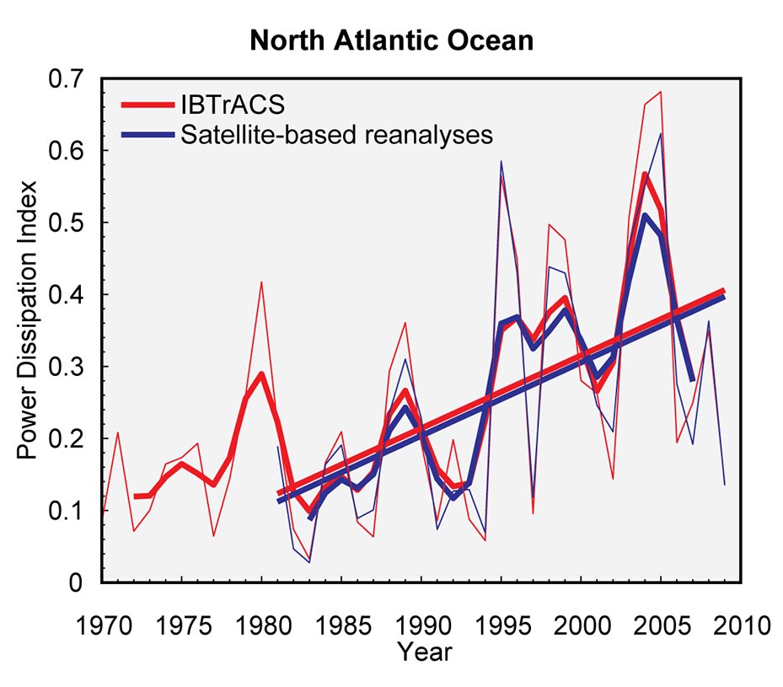
Source: NCA4
Notes:
The intensity, frequency, and duration of North Atlantic hurricanes, as well as the frequency of the strongest (Category 4 and 5) hurricanes, have all increased since the early 1980s. Models project that hurricane intensities and precipitation will further increase as the climate warms.

Slide 32
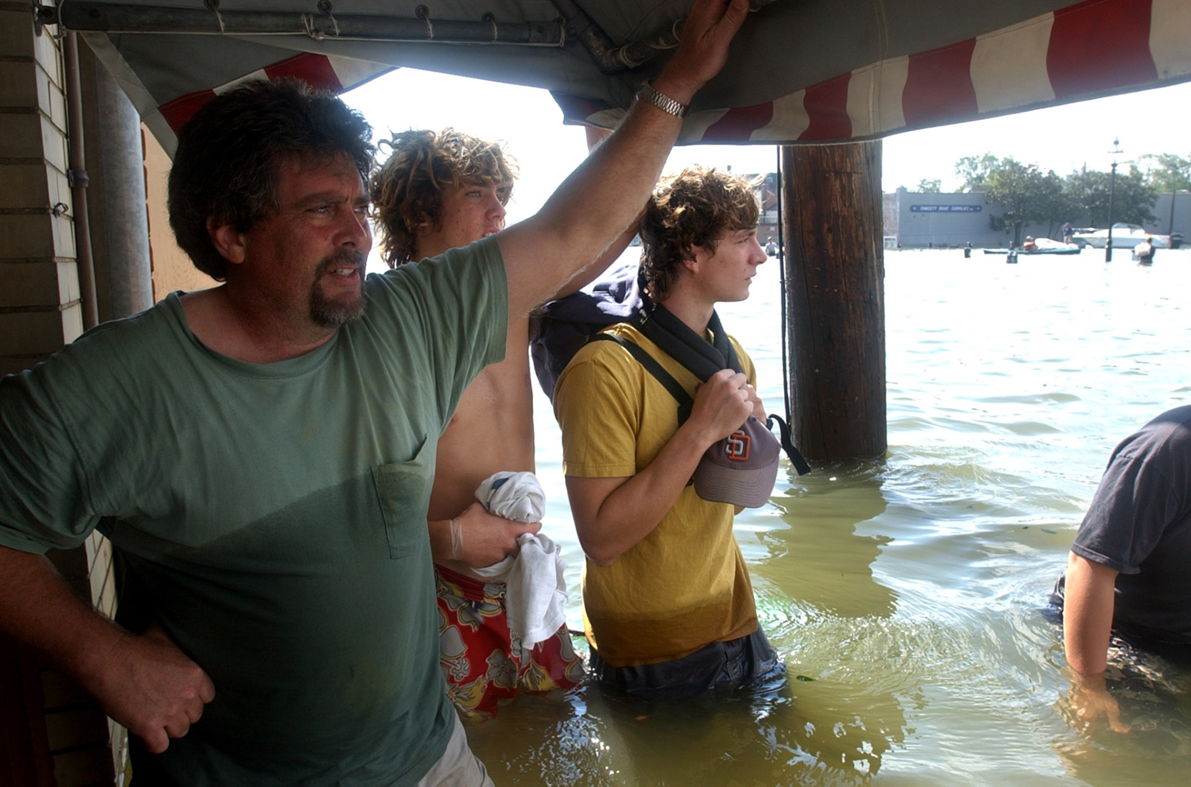
Storm surge
Photo: AP
Notes:
Sea level rise is expected to further increase the extent of inland flooding from coastal storms. Shown here is flooding in downtown Annapolis, MD (where I live) from Hurricane Isabel.

Slide 33
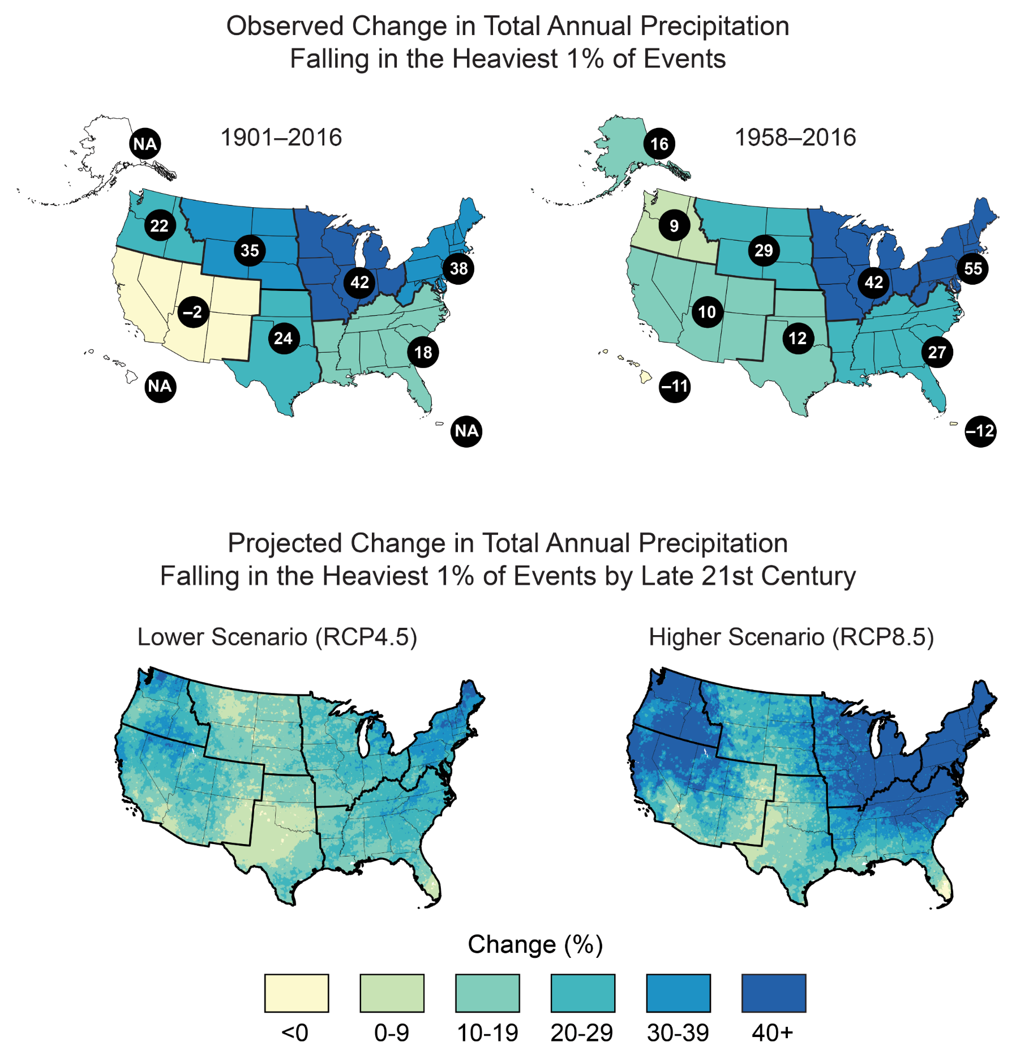
National Climate Assessment
Notes:
Many regions of the country are already seeing more of their precipitation being concentrated into heavier precipitation events, creating potentially severe flooding. Then, we’re seeing longer periods of drought in between those strong storms.

Slide 34
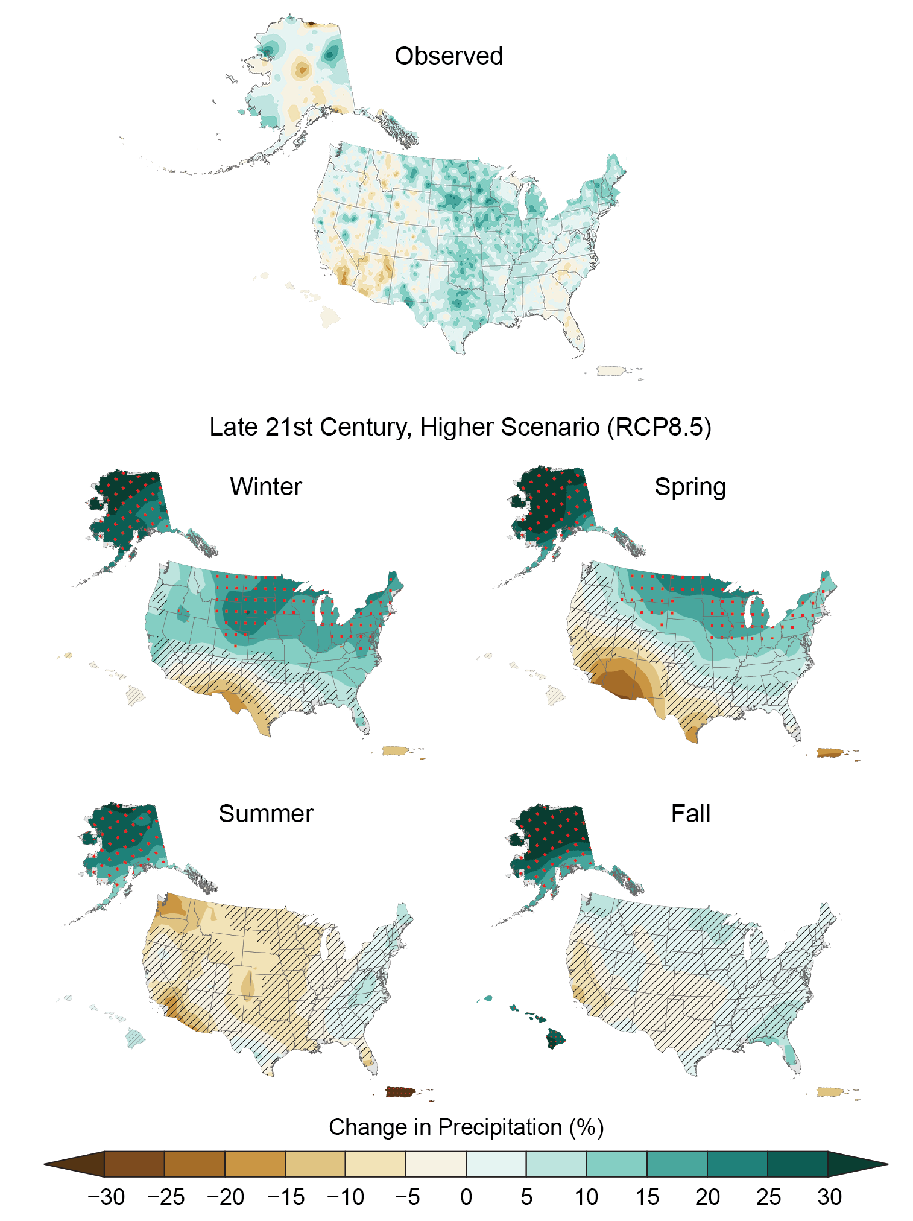
National Climate Assessment
Notes:
Due to higher temperatures increasing evapotranspiration, droughts have reached record intensity in parts of the U.S. The western US, especially the Southwest, is predicted to dry even further due to reductions in precipitation and increased evaporation. The Southwest is already in a mega-drought, the worst in 500 years, and the Pacific coast has also experienced severe droughts recently.

Slide 35
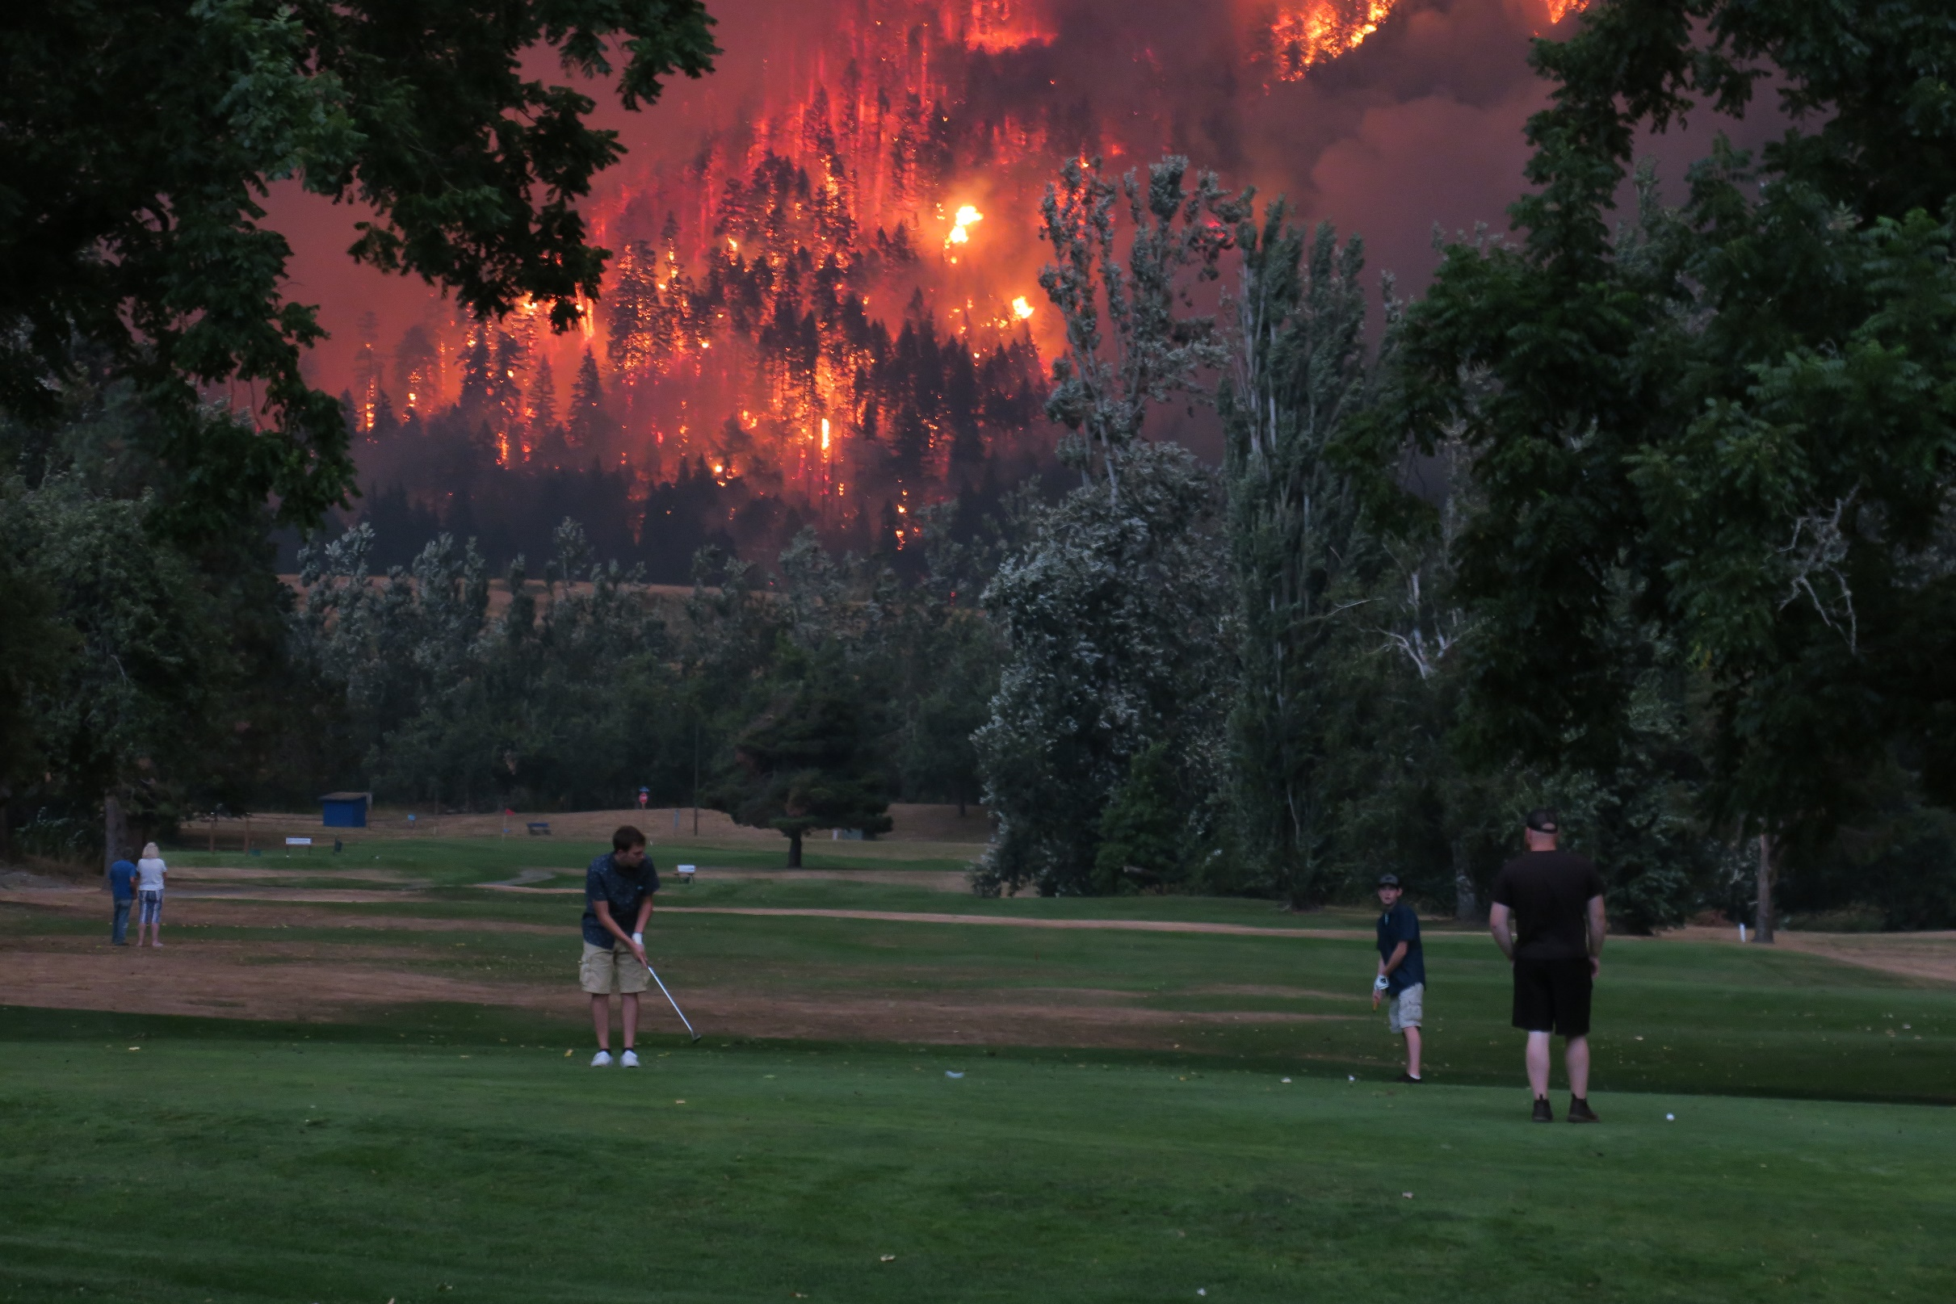
Increasing Wildfires
Notes:
With increased drought, we are seeing increasingly calamitous fires all over the world. The incidence of large forest fires in the western U.S. and Alaska has increased since the early 1980s, and is projected to further increase as the climate warms.

Slide 36
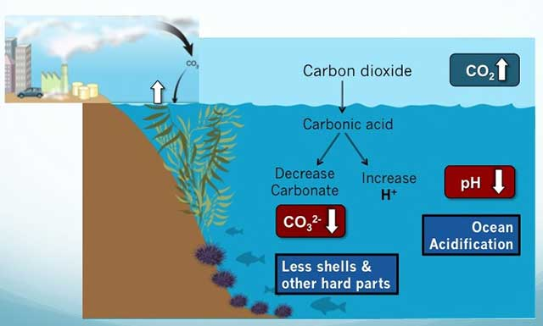
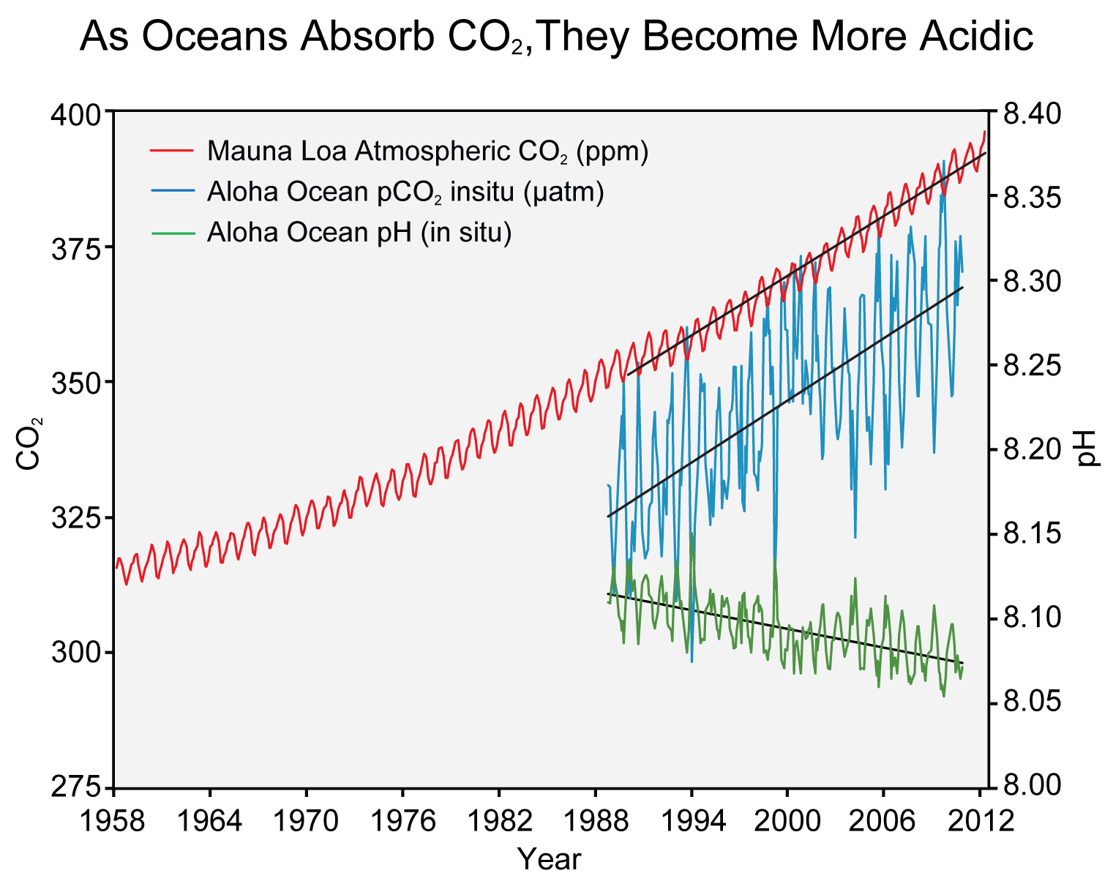
Ocean Acidification
NOAA
Source: NCA
Notes:
The world’s oceans take up roughly a quarter of the carbon dioxide emitted every year. Most of this CO₂ dissolves into the surface seawater and forms carbonic acid. The oceans have become 30% more acidic, and hydrogen ion concentration is projected to continue to increase at 0.5% to 1.0% per year.

Slide 37
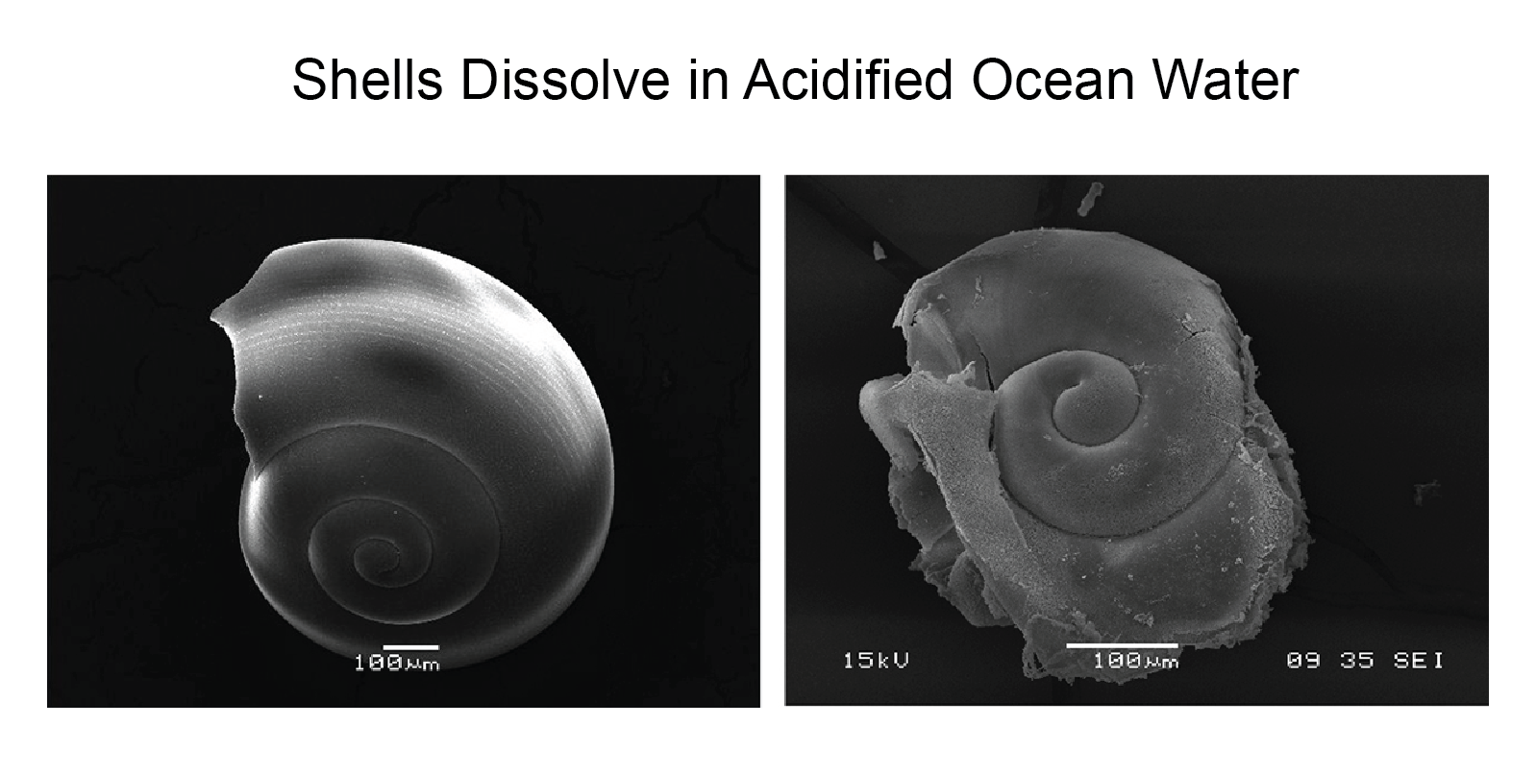
Source: Nina Bednarsek, NOAA Pacific Marine Environmental Laboratory
Coral reefs
Plankton
Shellfish
Notes:
This impacts shell formation and the entire food webs of the oceans.

Slide 38
Climate Change Also
Increases the Risk of Many
Infectious Diseases
Cholera
Dysentery
Hepatitis A
Typhoid
Fever
E. coli
Cryptosporidium
Campylobacter
Notes:
Climate change can increase the risk of many infectious diseases, through increased temperatures, heavier rainfalls, and tropical diseases moving further north. Warming can allow mosquitos or ticks to expand their habitat ranges and reproduce more frequently. Some viruses also incubate faster inside mosquitos and other vectors when temperatures are hotter.

Slide 39
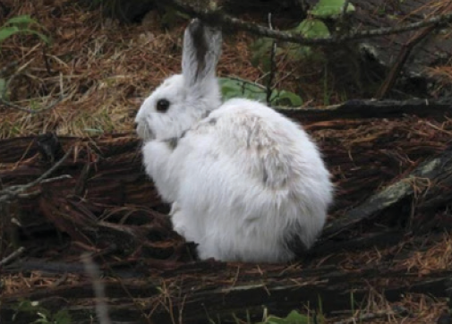
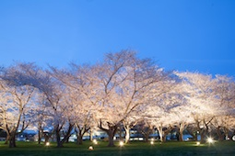
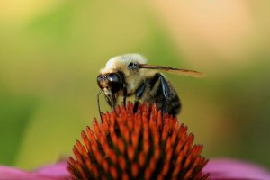
Phenologic Mismatch
USFS
Carol Highsmith (LOC)
Foster Lea
Notes:
Phenology refers to the timing of life events: Migration, flowering, pollination, seasonal color change are important for many species. If part of the equation is flexible (tied to climate cues) and part isn’t (e.g., cued to day lengths) that no longer correspond to weather events.
Can be annoying: You book your flight to DC for the Cherry blossom festival for Mid-April and the bloom happens in late March.
Can be fatal: For instance, if a species migrates based on changes in day length, but a food supply that it requires is responding to cues of temperature or snow melt, these interactions can be thrown off.
The shift in coat color is caused by release of hormones in the brain in response to changes in the amount of daylight. Historically, these changes in day length were reliably correlated to the onset of snow cover in the fall, and its melt in the spring. However, with the climate warming in these areas, the number of days with snow cover is decreasing. In both fall and spring, researchers are seeing more hares whose color no longer matches their environment. By tracking individual animals, they have also learned that mortality from predation is much higher at these times, when they are so conspicuous. While hares in a few locations stay brown year-round, researchers have not found any flexibility in the timing of autumn molt for populations that change color
In a 2003 paper, Parmesan and Yohe analyzed 172 species and showed that migratory birds, amphibians and other animals were breeding earlier in the spring, and plants and flora blooming earlier. These behaviors have happened an average of two days per decade earlier than normal. A review of a larger set of less-detailed studies produced similar results. Global warming accounted for a shift to an earlier spring for 677 species studied. And 80 percent of the changes in distributions of 893 species could be predicted by climate change.
For example, ecologist David Inouye has found that in the Colorado mountains, has seen the winter snow melt earlier, the result of warmer springs, less snowfall during the winter and more dust carried in by storms, which accelerates melting. The last frost, however, continues to happen at about the same time. this is bad for the Mormon fritillary butterfly since an early start to the growing season may put caterpillars and the flower buds that could later feed adult butterflies at the mercy of frosts. Migratory broad-tailed hummingbirds, which also consume the flowers' nectar, are arriving earlier in the spring now, but they aren't quite keeping pace with the first flowers, a potential mismatch that could ultimately lead to fewer flowers for the birds to pollinate, said Inouye.
Snowshoe hares and several other arctic species turn white in winter and brown in summer for camouflage (from either predators or prey). Some of these changes are now happening “out of season.”

Slide 40

Notes:
This shows projected changes, impacts and risks to humans and ecosystems for land-based processes, compared to the temperature increase. At the 1.1 degree of warming that’s already occurred, we are already seeing water scarcities, soil erosion, vegetation loss, wildfire damage, permafrost degradation, crop yield declines, and food supply instabilities. The higher the temperature climbs, the more severe the impacts. Above 2 degrees, we will almost certainly see sustained food supply disruptions globally and major permafrost melting. Melting permafrost will release more CO2 and methane into the atmosphere, one of the feedback loops that will make temperatures climb even higher. Above 3 degrees, we will see many vegetated areas turn into deserts.

Slide 41

Notes:
This shows projected changes, impacts and risks for ocean regions and ecosystems, compared to the temperature increase. Warm water corals are already in trouble from the 1.1 degree of warming that’s already occurred, and may disappear above 1.5 degrees. We are also seeing impacts to kelp forests. Above two degrees we will see impacts to all but deep-water habitats. The higher the temperature climbs, especially considering the increase of extreme heat waves, the more habitats will be impacted and the more will be lost.

Slide 42

Notes:
Climate change isn’t the only stress on ecosystems and local communities. Clearing forests and other natural land for agriculture or development is currently an even bigger threat to ecosystems and wildlife. Other threats include poaching, overfishing, pollution, and invasive species. But climate change makes all of these worse. It acts as a “threat multiplier.” Because humans rely on a healthy environment for their existence and well-being, impacts to ecosystems equate to impacts to people. The coronavirus pandemic is an example of that, and possibly a harbinger of worse to come.

Slide 43
What can we do about it?

Slide 44


Two Types of Responses
Mitigation: Intervention to reduce the sources or enhance the sinks of greenhouse gases (IPCC, 2001a).
Adaptation: Adjustment in natural or human systems . . . which moderates harm or exploits beneficial opportunity (IPCC, 2001a).
Tom Egan
EPA
Notes:
There are two basic types of responses to climate change. Mitigation means reducing the sources and enhancing the sinks of greenhouse gases, to reduce the extent to which climate change happens.
Adaptation is reducing the negative impacts of the change that does happen by adjusting natural and human systems to reduce the harm.

Slide 45

Notes:
We already have the technology to reduce climate change, by replacing fossil fuels with renewable energy, and capturing atmospheric carbon in plants and soils.

Slide 46

Drawdown Solutions by Effectiveness
http://www.drawdown.org/solutions-summary-by-rank
Notes:
Project Drawdown identified 80 different solutions to reduce greenhouse gas emissions or remove CO2 from the atmosphere. But no single solution can do the job; we have to consider all of them. Most would actually save money.

Slide 47

Drawdown Solutions by Effectiveness
http://www.drawdown.org/solutions-summary-by-rank

Slide 48

Drawdown Solutions by Effectiveness
http://www.drawdown.org/solutions-summary-by-rank

Slide 49

Drawdown Solutions by Effectiveness
http://www.drawdown.org/solutions-summary-by-rank

Slide 50

Notes:
First of all, we have to stop burning fossil fuels. Electricity production accounts for 25% of greenhouse gas emissions globally.

Slide 51

Notes:
Phasing out hydrofluorocarbons, which are used as refrigerants, would have an enormous impact. Hydrofluorocarbons, or HFCs, trap thousands of times as much heat as a molecule of CO2. Capturing HFCs from discarded air conditioners instead of letting them leak into the atmosphere could avoid the equivalent of 90 GT of CO2 emissions. And phasing out HFCs could avoid another 25-78 GT.
Other industry solutions include reducing waste and increasing energy efficiency. This will also save companies money.

Slide 52

Notes:
Transportation is responsible for 14% of global greenhouse gas emissions. Solutions include alternative means of transportation, increasing fuel efficiency and switching to electric vehicles.

Slide 53

Notes:
Buildings and homes can also be more energy-efficient.

Slide 54

Notes:
Reducing food waste and meat consumption are the #3 and #4 ways we can reduce greenhouse gas emissions. We also have to stop destroying forests and other natural ecosystems. We can also change agricultural practices to sequester more carbon. Population growth and resource consumption are key drivers of land use change, climate change, and biodiversity loss. Four strategies can reduce population growth: educating girls, family planning, empowering women in the workplace and society, and (although it may seem counterintuitive), reducing infant and child mortality.

Slide 55

Notes:
Land sinks currently sequester 26% of human-caused carbon emissions. Coastal waters and oceans also trap greenhouse gases. Restoring degraded land and ecosystems can increase the amount of carbon pulled out of the atmosphere.

Slide 56



Solar Radiation Management vs. CO2 Removal
Biochar & BECCS
https://en.wikipedia.org/wiki/Biochar
https://en.wikipedia.org/wiki/Bio-energy_with_carbon_capture_and_storage
Notes:
Solar Radiation Management is a type of engineering to reduce the amount of solar energy reaching the Earth’s surface by reflecting sunlight. These include deploying space reflectors, atmospheric aerosols, and reflectors in deserts and roof tops. Painting rooftops and parking lots white would reflect sunlight and also reduce the heat in urban areas. A better solution is to cover rooftops and parking lots with solar panels which would not only reduce solar heating, they would convert much of the sunlight to electricity.
Carbon dioxide removal is generally cheaper than Solar Radiation Management. Some proposals include fertilizing oceans with iron to create algal blooms that sink to the sea floor; exposing mantle minerals like olivine that combine with carbon—although this would be very damaging and expensive; and injecting CO2 underground, as is done in some oil extraction. All three of these are controversial with potentially problematic side effects. A much less intensive form of CO2 removal, with a lot of co-benefits, is sequestering it in plants and soils.

Slide 57

Forest Protection and Restoration
Notes:
We already have a perfectly engineered device to remove CO2 from the atmosphere. They’re called plants.
In their biomass and soil, forests are powerful carbon storehouses. Forest protection prevents deforestation emissions (which are 10-15% of global emissions) and enables ongoing carbon sequestration.
The most critical of all forest types is primary or old-growth forest. Examples include Tongass National Forest in Alaska, the Great Bear Rainforest of British Columbia, and the Amazon and Congo rainforests. With mature canopy trees and complex understories, these forests contain 300 billion tons of carbon and are the greatest repositories of biodiversity on the planet.
The benefits of forest conservation include not only carbon sequestration, but biodiversity protection, flood protection, aquifer recharge, recreation, and many other ecosystem services.

Slide 58


Notes:
Restoring degraded land can sequester CO2 in plants and soils. Depending on the current condition of the land, there are practices to optimize its carbon storage potential.

Slide 59


Biochar
Left: typical tropical soil
Right: Biochar soil (hundreds of years old)
Notes:
Biochar is charcoal used as a soil amendment. Like most charcoal, biochar is made from wood and other biomass via pyrolysis (high temperature breaking of chemical bonds without oxygen, so it doesn’t combust, or catch fire). Biochar is under investigation as an approach to carbon sequestration . Independently, biochar can increase soil fertility of acidic soils, increase agricultural productivity, and provide protection against some foliar and soil-borne diseases. Using biochar reduces pressure on forests by retaining soil fertility. Biochar is a stable solid, rich in carbon, and can endure in soil for thousands of years.

Slide 60

Climate Change Vulnerability
Notes:
The vulnerability of a species, ecosystem, or human community to climate change is a factor of exposure, sensitivity, and adaptive capacity.
Exposure measures the local change in climatic conditions.
Sensitivity measures how much that change might affect a certain species, ecosystem, or community.
Adaptive capacity measures the ability of a species, ecosystem, or community to respond to the threats.

Slide 61

COP 26
Notes:
The most recent global climate summit, COP26, was held last month. Importantly, countries agreed to attempt to limit warming to 1.5 °C, and if they fulfill the promises they made before and during the summit, warming could be limited to 1.8°C, far less destructive than the 4-5°C forecast when countries were doing nothing. Hundreds of financial institutions and other businesses also committed to net-zero emissions by 2050. And more than 140 countries pledged to reverse deforestation by 2030. Follow-up is needed to ensure that signatories meet and exceed their climate pledges, and start bending the emissions curve now rather than waiting until it’s too late.
https://defenders.org/blog/2021/11/cop26-achieves-progress-falls-short-of-whats-needed :
With the effects of climate change becoming more pronounced each year, it was imperative that climate negotiators make substantial progress at the COP26 global climate summit, held in Glasgow Nov. 1-13. The results were mixed, containing a lot of positive language, but less in terms of specific commitments and actions. And alas, representatives of the fossil fuel industry outnumbered the delegations of any single country.
In the final agreement, known as the Glasgow Climate Pact, countries stressed “the urgency of enhancing ambition and action” and resolved “to pursue efforts to limit the temperature increase to 1.5 °C,” recognizing that this would significantly reduce climate change risks and impacts. Importantly, the commitments countries set forth would, for the first time, likely hold total warming to about 1.8°C, a more ambitious target than the 2.7°C of warming estimated under the Paris agreement pledges. This of course assumes that countries will hold themselves accountable.
Another sign of progress was 110 countries pledged to cut emissions of methane 30% by 2030. Since methane is a very potent but short-lived greenhouse gas, curbing its emissions is an effective measure to reduce near-term global warming. Several of the world’s largest emitters of greenhouse gases made notable commitments. The U.S. and China announced a joint agreement to do more to cut emissions this decade, and China committed for the first time to developing a plan to reduce methane. Nonetheless, the agreement was short on specifics.
India’s Prime Minister announced that India intends to generate half its electricity from renewables by 2030 and achieve net zero emission status by 2070. This is well short of the target date of 2050, but was a stronger pledge than what has been made by Saudi Arabia, the planet’s second-biggest oil producer, and by Russia, the second-biggest gas provider.
One of the most significant deals at COP26 involved the private sector. Nearly 500 global financial services, holding 40% of the world’s financial assets—a total of $130 trillion—agreed to meet the goals of the Paris Agreement, including limiting global warming to 1.5 ⁰C. The commitment “comes with a pathway by which the companies involved must use science-based guidelines to reach net-zero emissions by 2050, and commit to interim goals towards a 50 percent reduction by 2030.” This means adjusting their business models, developing credible decarbonization plans, implementing them and providing annual reports.
COP26 came tantalizingly close to calling for an end to coal, the most polluting of the fossil fuels, but late in the negotiations, the Pact language was weakened from “phase out” to “phasedown.” The final language, which reads, “accelerating efforts towards the phasedown of unabated coal power and phase-out of inefficient fossil fuel subsidies,” allows room for continued coal use, such as with carbon capture. Forty-six countries, five subnational territories and a range of electricity providers, pension funds and other organizations pledged to phase out existing coal-fueled power plants and stop building new ones. However, the biggest coal producers and users like Australia, India, the U.S. and China did not join the pledge.
Although the Pact “emphasizes the importance of protecting, conserving and restoring nature and ecosystems, including forests and other terrestrial and marine ecosystems,” progress here was hampered by lack of enforcement mechanisms. More than 140 countries representing over 90% of the world’s forests, including Brazil, China, Russia and the United States, pledged to strengthen shared efforts to halt and reverse deforestation by 2030. Forests are crucial to absorbing carbon dioxide and slowing the pace of global warming, as well as supporting biodiversity. The pledge includes $19 billion of public and private funds, which is better than nothing, but far short of the amount needed. Perhaps more important, there are no consequences for not following through, and a similar deal in 2014 failed to slow deforestation in any way.
Fighting climate change requires much more than a two-week annual summit. It must be a continual, year-round commitment. Follow-up is needed to ensure that signatories meet and exceed their Glasgow pledges.
In a statement released at the end of the meeting, U.N. Secretary-General António Guterres said COP26 was an important but insufficient step. “It is time to go into emergency mode,” he said, “[and] accelerate action to keep the 1.5 degree goal alive.” The U.N. chief called for ending fossil fuel subsidies, phasing out coal, putting a price on carbon, protecting vulnerable communities and delivering the $100 billion climate finance commitment.
Guterres also had a message for climate activists: “I know many of you are disappointed. The path of progress is not always a straight line. But I know we can get there. We are in the fight of our lives.”
The Glasgow Climate Pact calls on countries to come to next year’s COP, set to take place in Egypt, with stronger and more detailed plans for cutting their emissions. In addition, wealthy countries were urged to increase adaptation funding to protect the most vulnerable nations from the hazards of a hotter planet.

Slide 62



Climate Change Adaptation Strategies
Resistance Strategies: Attempt to keep a system intact relatively unchanged (reduce exposure)
Karen Salyer
Resilience Strategies: Improve the system’s ability to “bounce back” from a disturbance (reduce sensitivity)
DoW
Transformation strategies: Facilitate system responding in new ways (improve adaptive capacity)
Aaron McCall
Notes:
Now I’ll talk about Climate Change Adaptation Strategies. I’m mostly going to discuss it from an ecological standpoint, but it applies to human communities and infrastructure too. These include:
Resistance: Attempting to keep a system intact and relatively unchanged
Resilience: Improving the system’s ability to “bounce back” from a disturbance
and Transformation: Facilitating system to respond in new ways, like planting species adapted to a hotter climate.

Slide 63




Resistance Strategies
Tongass National Forest. Photo: John Schoen
Mott MacDonald
NRCS
DNREC
Notes:
Resistance Strategies include things like protecting existing ecosystems from development, overharvesting, and stressors like fire, disease, and invasive species. They also include restoration, like restoring degraded streams and planting riparian vegetation, restoring wetlands, dune systems, and other ecosystems.

Slide 64

Climate Refugia
The Amargosa is the only free-flowing river in the Death Valley region of the Mojave, providing a rare and lush riparian area in the desert.
Photo: Bob Wick, BLM
Notes:
Resistance Strategies also include protecting climate refugia, which are areas that heat up slower or remain moist as the climate changes.

Slide 65




What Are Refugia?
(Photo: Bob Wick, BLM)
(Photo: John Meikle/WCS Canada)
Notes:
Environmental changes, whether relatively sudden (e.g., fires, storms, or floods) or more gradual (changes in climate) are typically patchy; some areas are affected more than others. Refugia are areas where species, natural communities, or ecosystems can persist within a larger area that has been rendered inhospitable. They can occur at different scales of space and time, and provide temporary safe havens. Effective climate refugia protect at-risk species and ecosystems, may often (although not always) occur in large natural areas, and provide connectivity “stepping stones” and population resilience.

Slide 66

Examples of processes and landscape features contributing to disturbance refugia
(Krawchuk et al., 2020)
Notes:
Disturbance refugia are areas more likely to persist through disturbances like fire, drought, storms, or insect outbreaks, or more likely to recover from them. Since climate change is likely to increase the frequency and magnitude of many types of disturbances, identifying disturbance refugia is essential to maintain local species and ecosystems.
This figure shows examples of processes and landscape features that help form disturbance refugia. These can be natural, like terrain shading, rivers and lakes, or moist soils; or human constructs, like roads and trails. Roads can have many negative ecological effects, but can serve as firebreaks.

Slide 67

Climate Refugia in the U.S. and Canada
Multispecies end-of-century (2071–2100) refugia indices averaged across (a) 324 tree species, (b) 268 songbird species (Stralberg et al., 2018).
Notes:
Climatic refugia operate on longer scales of time. Such areas are relatively buffered from changes in regional environmental conditions (e.g., temperature or moisture), and allow organisms to persist as long as local conditions remain tolerable. Climate-change refugia may only be temporary for a given species, but can delay ecosystem transitions for decades or longer. They can serve as a “slow lane,” protecting native species and ecosystems from negative effects of climate change in the short term, providing longer-term havens for overall biodiversity and ecosystem function, and reducing the risk of extinction.
This isn’t the first time species have had to adapt to a changing climate, although it’s happening a lot quicker now and potentially to a greater extreme. During the Pleistocene, organisms took refuge from unfavorable climate conditions during glacial advances and retreats. These areas acted as sources for colonization when conditions beyond the refugia became more favorable. For example, areas in the southeast US served as refugia during the last glacial maximum (18,000–25,000 years ago).
Approaches for identifying future climate refugia include identifying regions that are projected to experience less severe climate changes, that contain a diversity of physical and topographic features, and that either retain or remain close to suitable climatic conditions for particular species. Stralberg et al. (2018) used species distribution models for 324 trees and 268 songbirds in the U.S. and Canada, along with predicted changes in habitat suitability, to identify areas more suitable as climate refugia. They found that the potential for future refugia was highest in mountain ranges and coastal areas.

Slide 68

Types of climate refugia
(Morelli et al., 2016)
Notes:
This picture shows examples of areas that could provide suitable climate refugia. Shaded areas, like north-facing slopes, receive less solar heating and will stay cooler by around 2-6 ⁰C depending on steepness and other factors. Valleys and coves that pool cold air will also stay cooler. Areas near large deep lakes or oceans will also warm more slowly due to the high heat capacity of water. Cold-water springs and streams will remain relatively cold if fed by groundwater. Persistent snow can provide critical habitat for species like snowshoe hares and wolverines. And tree canopies keep the ground beneath them cooler during the day.

Slide 69

Wetlands and other moist areas
(McLaughlin et al., 2017)
Notes:
Wet areas, including wetlands, riparian zones, and fog belts, can act as climate change refugia, especially if fed by groundwater. They can remain wet or moist during droughts. This moisture can also cool the air.
Many wetlands, especially if underlain by impermeable clay or water-retaining peat; can hold water for a long time. Wetlands, as long as their soils are saturated or moist, are more resistant to fire, and may also protect surrounding uplands from drought and fire.
For humans, protecting and restoring forests and wetlands can reduce flooding during storms and retain needed water during droughts, among their many other benefits.

Slide 70

Notes:
Here’s some examples of climate change refugia in the Sierra Nevada range, including areas where cold temperatures and snowpacks persist, areas that are less likely to burn, wet areas, and old growth forest.

Slide 71


Springs
Warm Springs, Nevada
(photo: U.S. Fish and Wildlife Service)
Moapa dace, an endangered fish found only at Warm Springs, Nevada
(photo: U.S. Fish and Wildlife Service)
Notes:
In arid or semi-arid regions, groundwater-fed seeps and springs are biodiversity hotspots. Many contain rare species, like the Moapa dace shown here. Some springs may provide stable hydrologic refugia during droughts, and are critical to fish and other water-dependent species. They also provide sources of water and food for nearby wildlife. The groundwater source must be protected for these springs to persist, and native vegetation protected or restored.

Slide 72


Aquatic refugia
Multifunctional aquatic refugia system. It includes long-term refugia for cold-water organisms, foraging and spawning locations, and shelter from disturbances like floods and droughts. In some cases, barriers (black bar in the figure) may be needed to keep out predators, invasive competitors, or diseases.
(Ebersole et al.,2020)
Cold‐water refuges (blue circles) under (a) current conditions and (b) a modeled 4°C warming scenario. Red circles indicate existing refuges likely to lose summer cold‐water habitat.
(Ebersole et al., 2020)
Notes:
Cold-water aquatic organisms, like salmon, trout, hellbenders, and spring salamanders, are among the most vulnerable species to climate change. Streams and rivers with cold groundwater inputs provide cold, sustained streamflows in regions where water temperatures would otherwise become too warm, or streamflows too low, during the summer months. Shading by valley walls or trees can also help regulate stream temperatures. Sufficiently large and connected cold-water stream networks can provide refugia for sensitive freshwater organisms facing increasing pressures from temperature increases and other stressors.
The figure on the left illustrates a sample aquatic refugia system. Refugia should meet all the species habitat needs, as well as shelter from high temperatures, floods, and droughts. And they should be large enough and connected enough to support viable populations. In some cases, barriers (depicted by a black bar in the figure) may be needed to keep out predators, invasive competitors, or diseases. The surrounding drainage area, or watershed, should be managed to provide stable flows and minimize pollution.
The figure on the right shows cold‐water refuges in MA (the dark blue circles) (a) under current conditions and (b) in a modeled 4°C warming scenario. Red circles indicate existing cold‐water refuges likely to lose cold‐water habitat in summer months.

Slide 73




Resilience Strategies
Increase reproductive capacity
Address other threats
Improve ecosystem function
Notes:
Resilience Strategies improve a system’s ability to “bounce back” from a disturbance. This can be done by reducing other ecosystem stressors, like restoring native vegetation, limiting pollution, reducing hazardous fuels and thereby preventing catastrophic fires, and controlling invasive species and pathogens. Wildlife can be helped by providing things like nest boxes if needed.

Slide 74




Transformation Strategies
“Pre-store” to future conditions
Provide for species movement
Notes:
Finally, transformation strategies help ecosystems to respond in new ways. For example, improving landscape connectivity to allow wildlife and plant range shifts. Or adding species that are more heat-tolerant, or, if applicable, drought-tolerant or salt-tolerant.

Slide 75




Climate Corridors
(USDA)
(USDA)
(USDA)
(John McLane)
Notes:
Climate corridors can facilitate long-distance migration of species as the climate changes. Climate corridors can be modeled between current and future distributions of species or climate types. Some examples include preserving natural corridors or stepping stones from south to north, or up to higher elevations, allowing species to move to more suitable climates. Likewise, corridors can be identified from drought-impacted areas to areas with more available water. Streams and rivers, and the adjacent riparian zone, can make especially suitable corridors if they are protected, and restored if necessary.

Slide 76

Apply dredged or pumped sediment to raise marsh elevation
Restore vegetation
Control invasive species that damage marsh
Acquire lands within current boundary that will persist as marsh
Expand refuge boundaries
Thompson et al. 2020
Notes:
Climate adaptation will often employ multiple types of strategies. At Blackwater NWR, dredged silt and sand were used to build up an area of marsh that was disappearing from sea level rise. Marsh grasses were planted and invasive nutria removed. The refuge is also acquiring forest and farmland at adjacent higher elevations where the marsh can migrate over time and continue to provide marsh bird habitat and other benefits. There’s often overlap between adaptation and mitigation; for example, saving and restoring coastal marsh also sequesters carbon in the form of peat.

Slide 77



What YOU Can Do
Personal climate footprint
Political Action: Support climate action at the local, state and federal level
Work locally to support climate resilience
  Pollinator habitat
  Ecosystem restoration
  Land protection
  Tree planting
Notes:
Everyone can help bend the curve away from the most catastrophic climate change consequences. You can:
Reduce your personal climate footprint
Ask your legislators, governors, and other political leaders to support climate action
And work locally to support climate resilience
Plant pollinator habitat
Help restore ecosystems
Support land protection efforts
Plant trees

Slide 78
For more information:
National Academy of Sciences: https://www.nationalacademies.org/topics/climate
NASA: https://climate.nasa.gov/
Intergovernmental Panel on Climate Change: https://www.ipcc.ch/
National Climate Assessment: https://nca2018.globalchange.gov/
Project Drawdown: https://drawdown.org/
Nature Climate Change (science journal): https://www.nature.com/nclimate/
Notes:
Here’s some of my sources of information.
My web site: https://www.tcweber.com/

